Slide 1
Developmental Evaluation: Why, How, and Making Better Decisions
Patrice Releford, Henriët Hendriks, Andrea Cummings, Jenny Johnson, and Brad Luckhardt // Wednesday, February 8, 2023

Slide 2
Agenda
Overview of Evaluation Purpose
Developmental & Equitable Evaluation
Developmental Evaluation in Practice
Key Action Steps and What We Learned
Questions
Break-out Groups

Slide 3
Overview of Evaluation
Purpose

Slide 4
OneMPLS Fund Overview
The OneMPLS Fund launched three years ago and pools money from the community to respond nimbly to pressing community needs.
Each grant round has addressed a different topic or community focus. Prior to the pandemic, the Fund addressed Housing. Since 2020, the fund has supported Pandemic Relief, Rebuilding and Capacity Building.

Slide 5
Evaluation Purpose
Foundation Level Outcomes
Use our Strategic Framework to guide learning and collaboration
Generate and use insights to guide OneMPLS Fund
Experiment with Developmental and Equitable Evaluation to inform the future of the Foundation's evaluation work
OneMPLS Fund Level Outcomes
Engage and learn with grantees, donors, and cross-departmental team to strengthen the Fund and understanding of the Fund

Slide 6
Developmental & Equitable Evaluation

Slide 7
What Does Developmental Evaluation Emphasize
Formative or summative evaluation approaches examine costs, benefits, best practices, replicability, scale, and in most cases quantitative evidence.
Developmental evaluation is (1) grounded in systems thinking and supports innovation amidst complexity (2) by collecting real-time data or feedback in ways that (3) lead to informed, ongoing decision-making about design, development and implementation.

Slide 8
Key Principles of Developmental Evaluation Michael Quinn Patton
Developmental purpose
Evaluation rigor
Utilization focus
Innovation niche
Complexity perspective
Systems thinking
Co-creation
Timely feedback

Slide 9
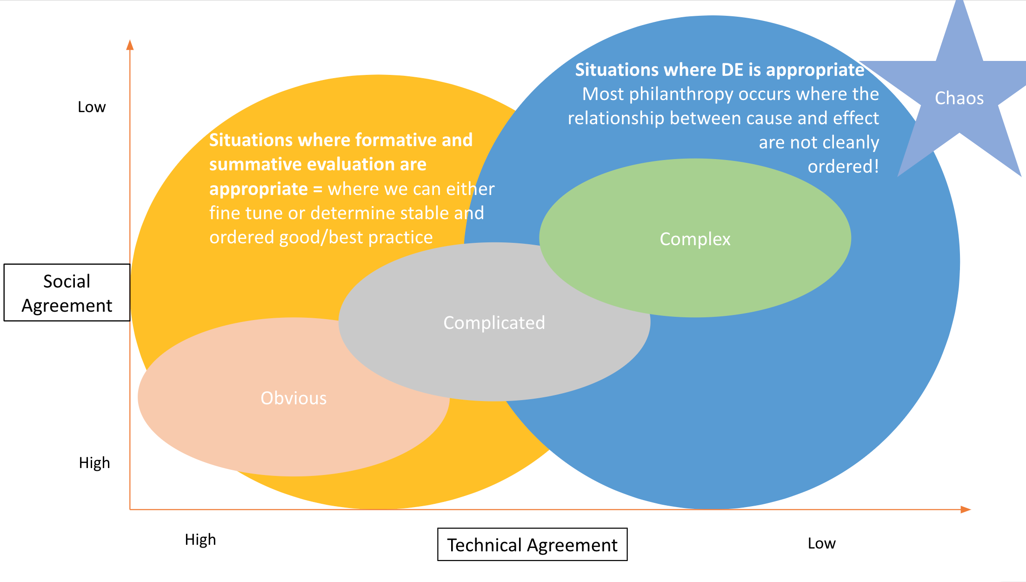
Choosing Evaluation Approach

Slide 10
Complexity of OneMPLS Fund
Three grant rounds happened in very different moments.
The identity of the OneMPLS Fund evolved rapidly during 2019 and 2020.
The moment when donors contributed and when grantees received support affected their perceptions of the fund and its purpose.

Slide 11
Journaling
Think about a Fund, Program, or Process in your organization that you are interested in for evaluation.
Where would you put that Fund, Program, or Process: Obvious, Complicated, or Complex?
Which type of evaluation might be the best fit: Formative, Summative, or Developmental Evaluation?

Slide 12
Developmental Evaluation
in Practice

Slide 13
Process Plan vs. Reality
Phase I
Grounding
Phase II
Inquiry
Articulate the initial desired outcomes and the initial process outline
Prepare foundation to engage with developmental evaluation
Grantee report review, interviews with grantees and donors
Iterative Learning
Data analysis
Phase III
Adoption & Reporting
Meaning-making to transform insights into learning and actionable change.
Disseminating learning and publishing evaluation results

Slide 14
What Developmental Evaluation Sounds Like
Insight from Grantee:
“Responsiveness is about letting communities determine what is priority and using our resources, whether that be human or process or financial or just influence, to be able to make sure that communities are heard. To make sure that community ideas are at the center of how we move forward or address certain challenges and things.”
Insight from Donor:
“I would like to see the leaders of this fund staying alert, being in a receptive mind, being on the lookout. That's the role the Foundation can play because donors are busy - they've got kids, work, stuff happening - grantees are too busy - they are out there doing the work in the city. The Foundation’s role is to be paying attention and being ready to respond as needed.”

Slide 15
What We Learned for Impact Team
Responsiveness
Value Quick Decisions & Allocation of Resources
Grateful for Flexibility & Opportunities to Innovate
Appreciate Simple Application Process
Would Prefer Conversational Reporting

Slide 16
Grantee Insights
Increased inclusivity and community engagement
Program and service continuity
Plan for and adapt to changes
Be responsive to the community's needs
Bridging a gap in financial support

Slide 17
What We Learned for Philanthropic Services
Trust in the Minneapolis Foundation
Desire to Make a Meaningful Impact in Minneapolis
Value of the OneMPLS Fund
Power of Responsiveness
Cautions about Responsiveness
Power of Collective Giving

Slide 18
How Did Developmental Evaluation change the conversation with Donors?
Changing perception of control
Changing what we needed to share with donors
Defining “responsive” grantmaking and redefining impact
Moving from “selling” Fund to “learning”
Understanding that the nature of the Fund won’t align or appeal with everyone

Slide 19
Key Action Steps and
What We Learned

Slide 20
What Developmental Evaluation Action Steps Look Like
Provide more clarity about the identity of the Fund
Clarify Messaging for All Stakeholders
Map out the Landscape of Featured Funds
Continuous Improvement & Effectiveness

Slide 21
Living Into What We Learned
Reflecting and evaluating our own strategies (not evaluating grantees)
Serving the community first, not necessarily the structures that exist within orgs
Decision-making affected by this evaluation process
Tool for embracing Framework and values with Donors and Fund Holders

Slide 22
Questions

Slide 23
Break-out Groups
Conditions for Our Success
Working group with representation from multiple departments, including leadership and decision-makers (ability to take learning into action)
People open to engaging in a dynamic and flexible process
Active participation in the meaning-making process
Challenge one another, disagree, consider new ideas, and continuously seek to strengthen the Fund
Questions for Discussion
Questions to determine if you are ready to try Developmental Evaluation?
Appropriateness? (Is DE the right thing?)
Institution’s readiness? Are people ready to learn? Open to qualitative measures? Can form a cross-developmental team to execute?
What are some of the pieces of DE that you could embrace?
Pick one big idea to share out from your group/table

Slide 24
Helpful Links
OneMPLS site https://www.minneapolisfoundation.org/onempls-fund/
Are You Really Ready For Developmental Evaluation? https://medium.com/@jcoffman/are-you-really-ready-for-developmental-evaluation-you-may-have-to-get-out-of-your-own-way-9c7e8ae7584b
“Developmental evaluation: Applying complexity concepts to enhance innovation & use” https://www.betterevaluation.org/tools-resources/developmental-evaluation-applying-complexity-concepts-enhance-innovation-use
Cynefin Framework https://www.youtube.com/watch?v=N7oz366X0-8

Slide 25
Patrice Releford, Henriët Hendriks, Andrea Cummings, Jenny Johnson, and Brad Luckhardt // Wednesday, February 8, 2023

