Slide 1
Greater Minnesota Philanthropy:
A Landscape of Opportunity
Kara Inae Carlisle, McKnight Foundation, & Matt Varilek, Initiative Foundation

Slide 2
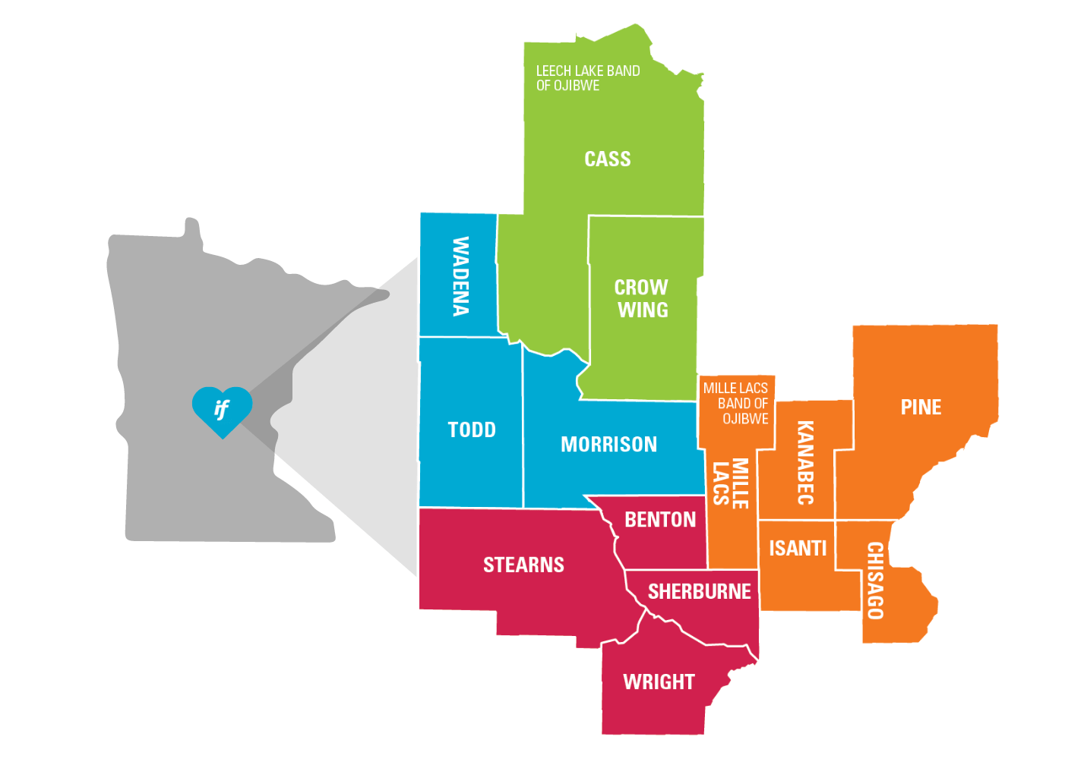
Serving Central Minnesota

Slide 3
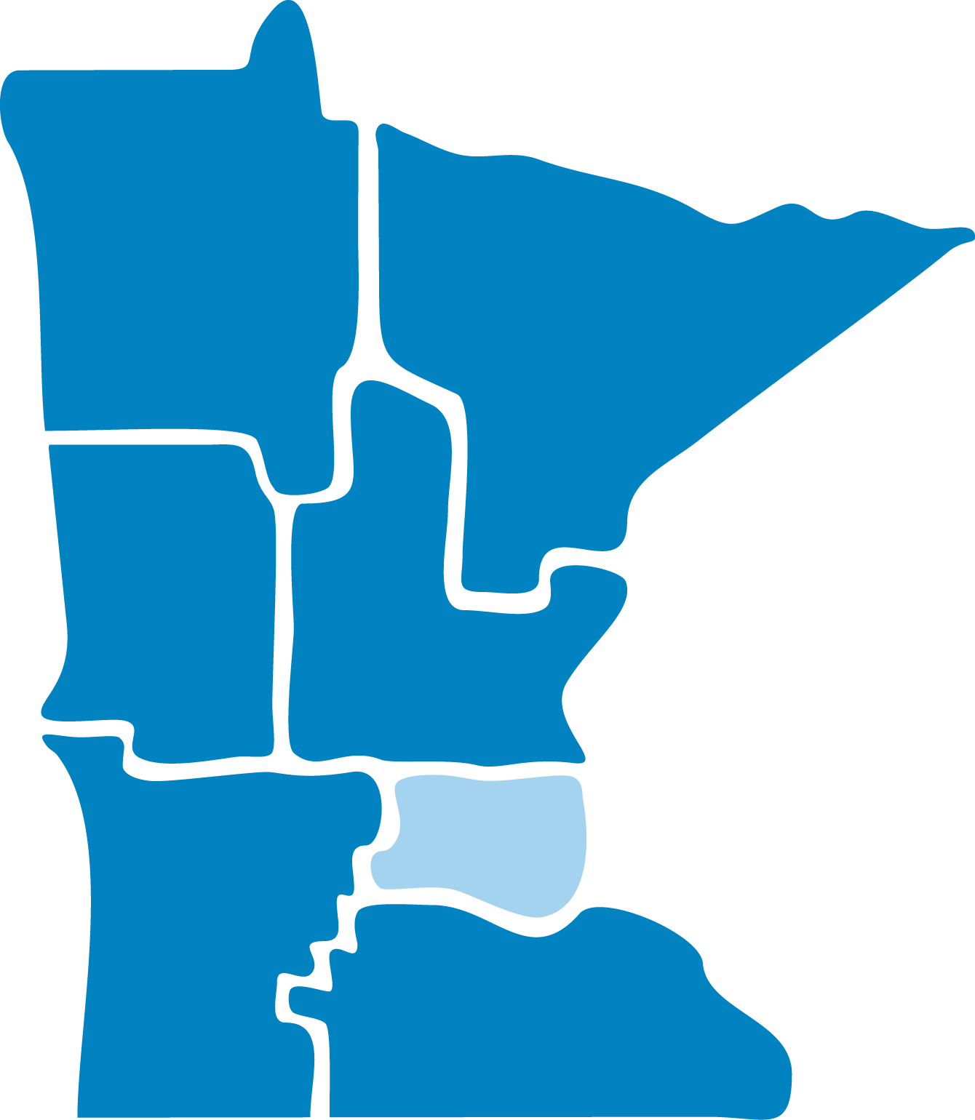
Initiative Foundation
Northland Foundation
Northwest Initiative Foundation
Southern Minnesota Initiative Foundation
Southwest Initiative Foundation
West Central Initiative

Slide 4
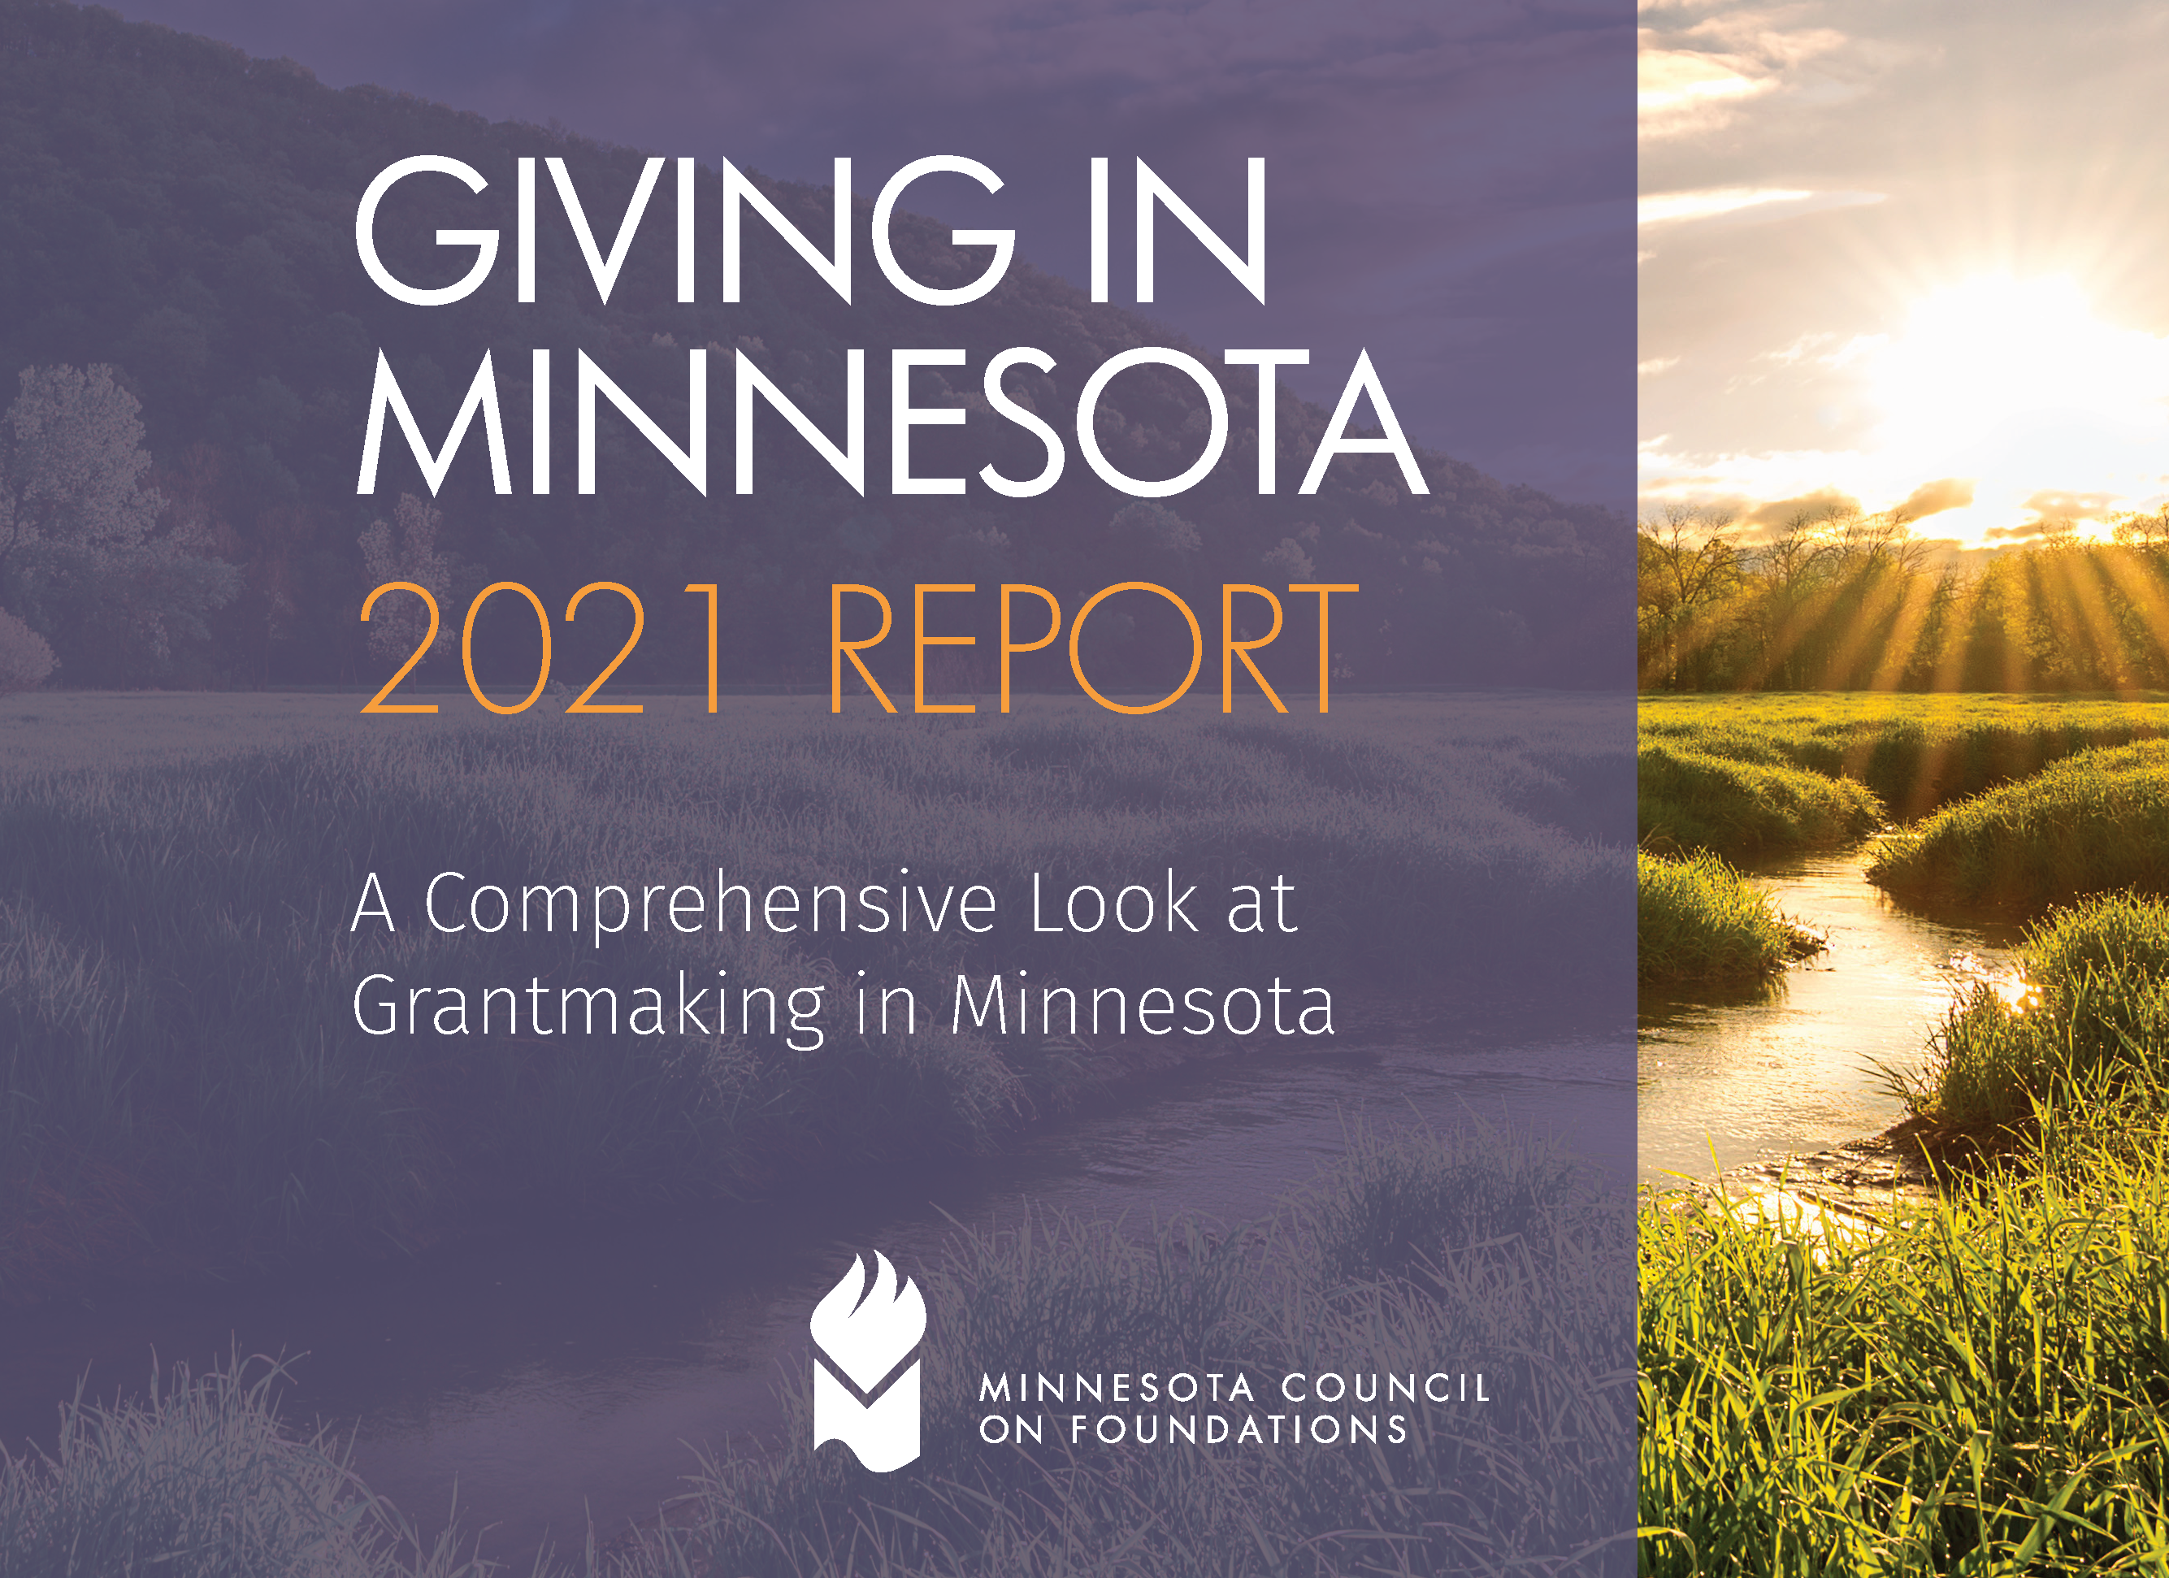
An Analysis of Foundation Giving

Slide 6
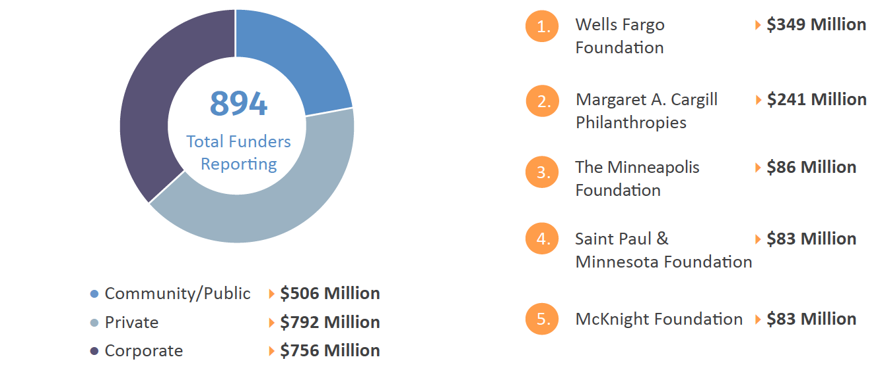
Charitable Giving by Organization Type, 2019
Top 5 Largest Givers + Amounts in Minnesota

Slide 7
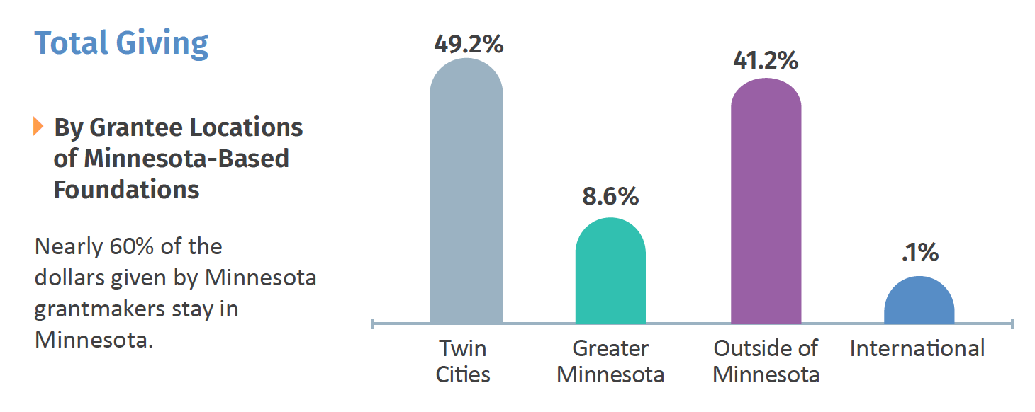

Slide 9
Twin Cities
Seven-county metropolitan area
Greater Minnesota
80-county region outside of the Twin Cities metropolitan area

Slide 13
Why Does It Matter?
Opportunity No. 1:
Low-hanging fruit across all foundation interest areas

Slide 14
Why Does It Matter?
Opportunity No. 2:
The political overlay. Leverage public trust across partisan boundaries to combat polarization.

Slide 16
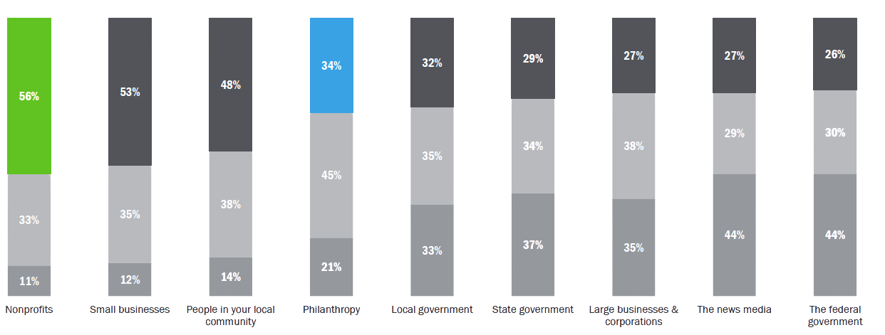
Nonprofits are More Trusted Than Government, the News Media and Large Corporations to do What is Right
Besides nonprofits, only small businesses and local community members are trusted by a majority or near-majority of Americans.
High Trust (7-9)
Neutral/ Don't Know (5-6)
Low Trust (1-4)
Source: Independent Sector "Trust in Civil Society" Survey, May 2022 (independentsector.org)

Slide 17
Why Does It Matter?
Opportunity No. 3:
The conference theme: An all-Minnesota opportunity to counter hate, address racial inequity

Slide 18
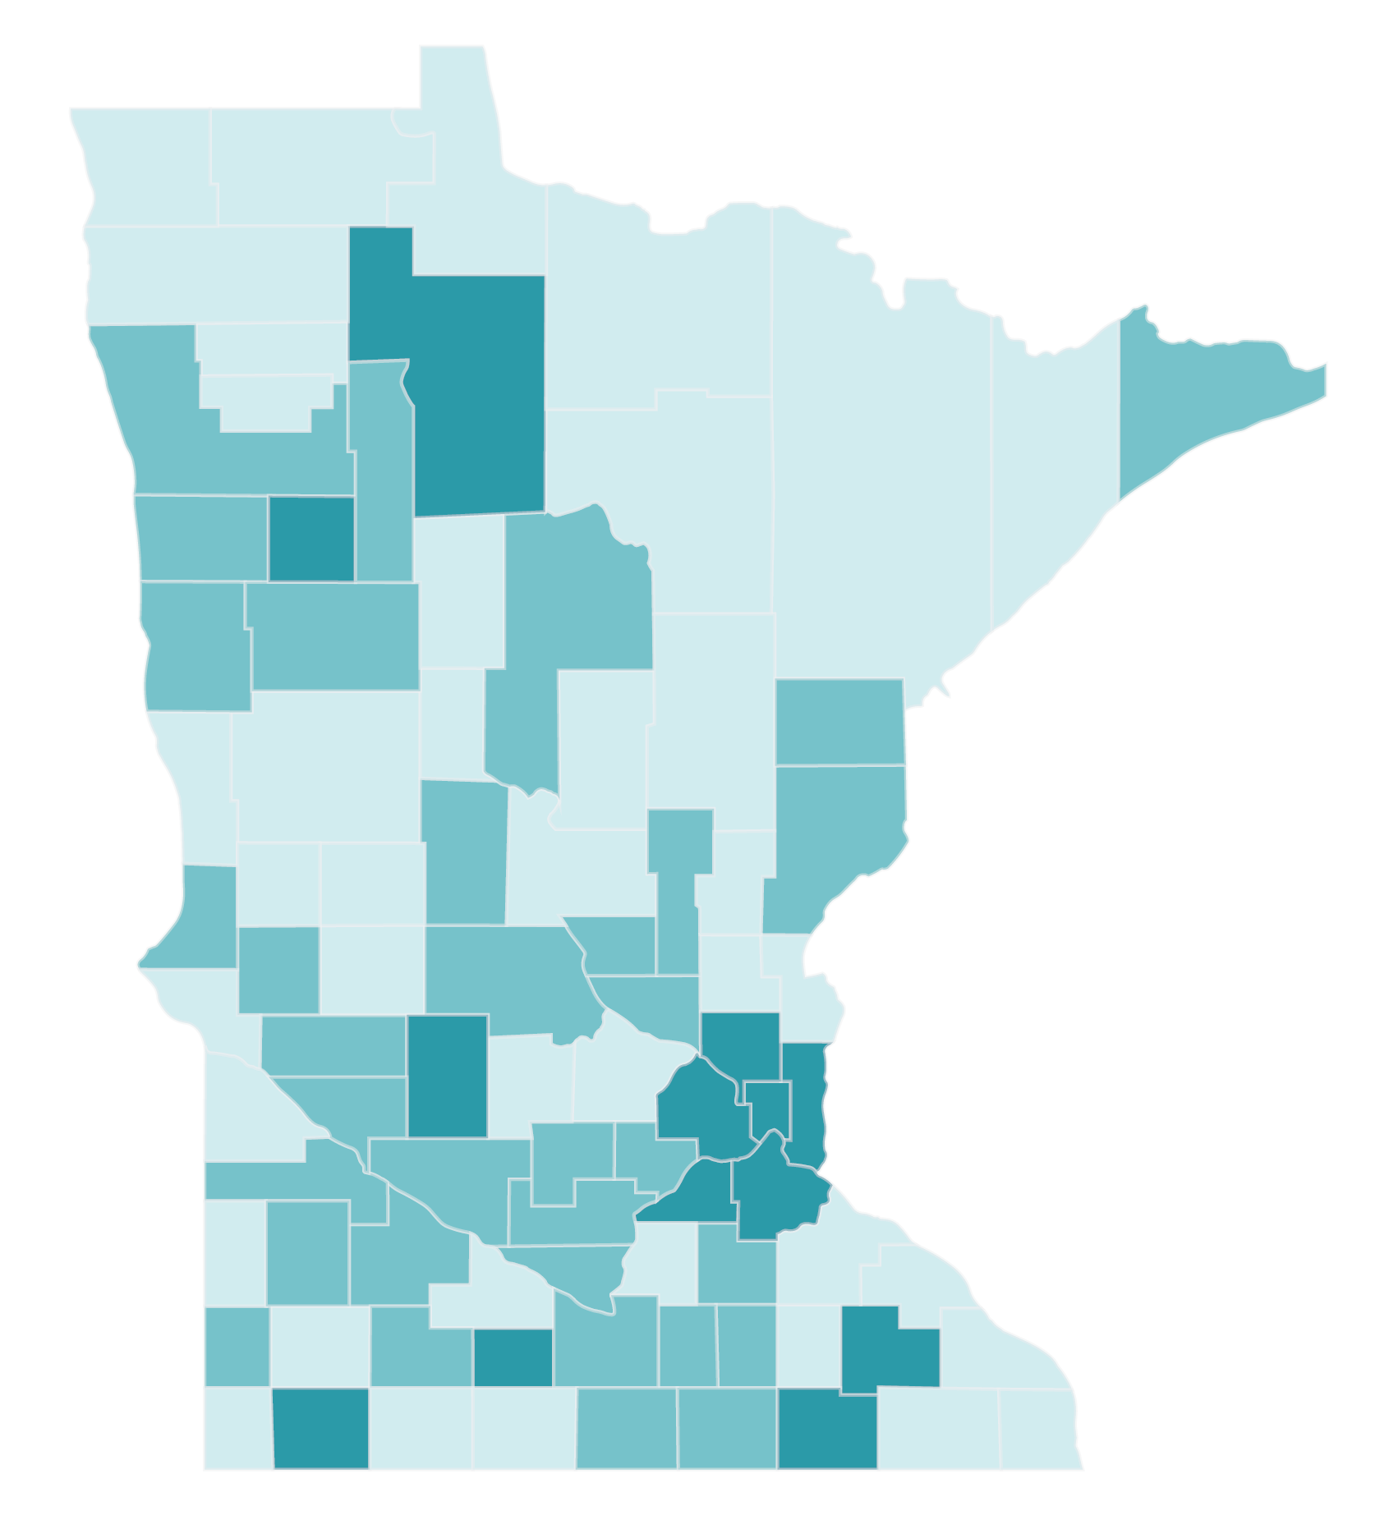
People of Color by County (2021)
Less than 10%
10.0 to 19.99%
More than 20%

Slide 19
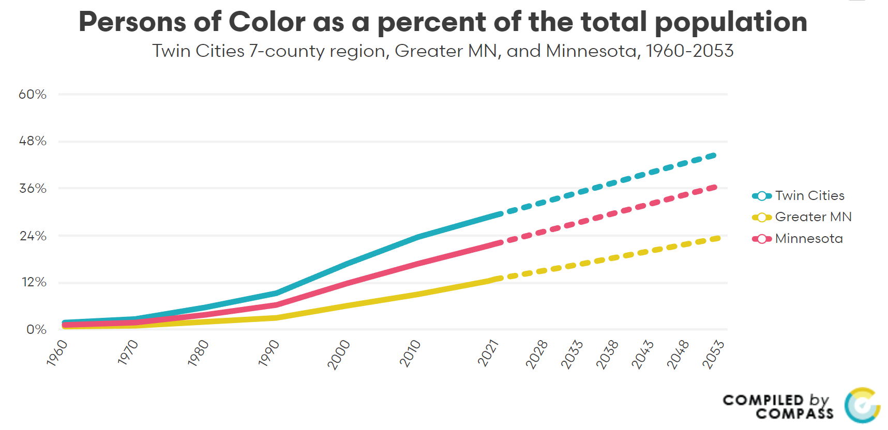
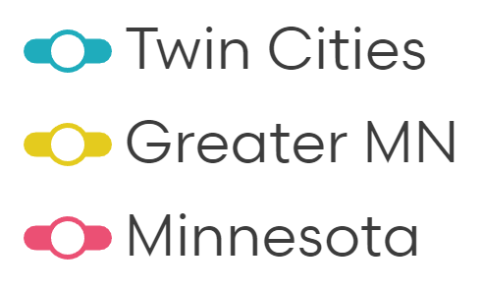
Persons of Color* as a Percent of the Total Population
*Persons of Color includes those who identify as Asian, American Indian, Black, Hispanic, and two or more races.

Slide 20
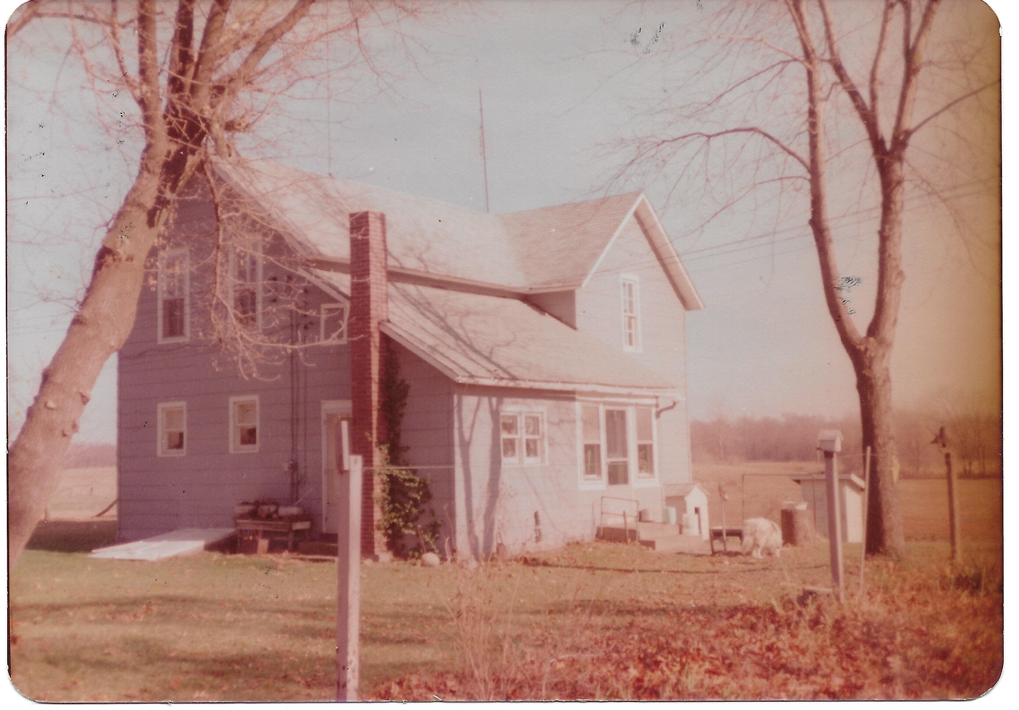
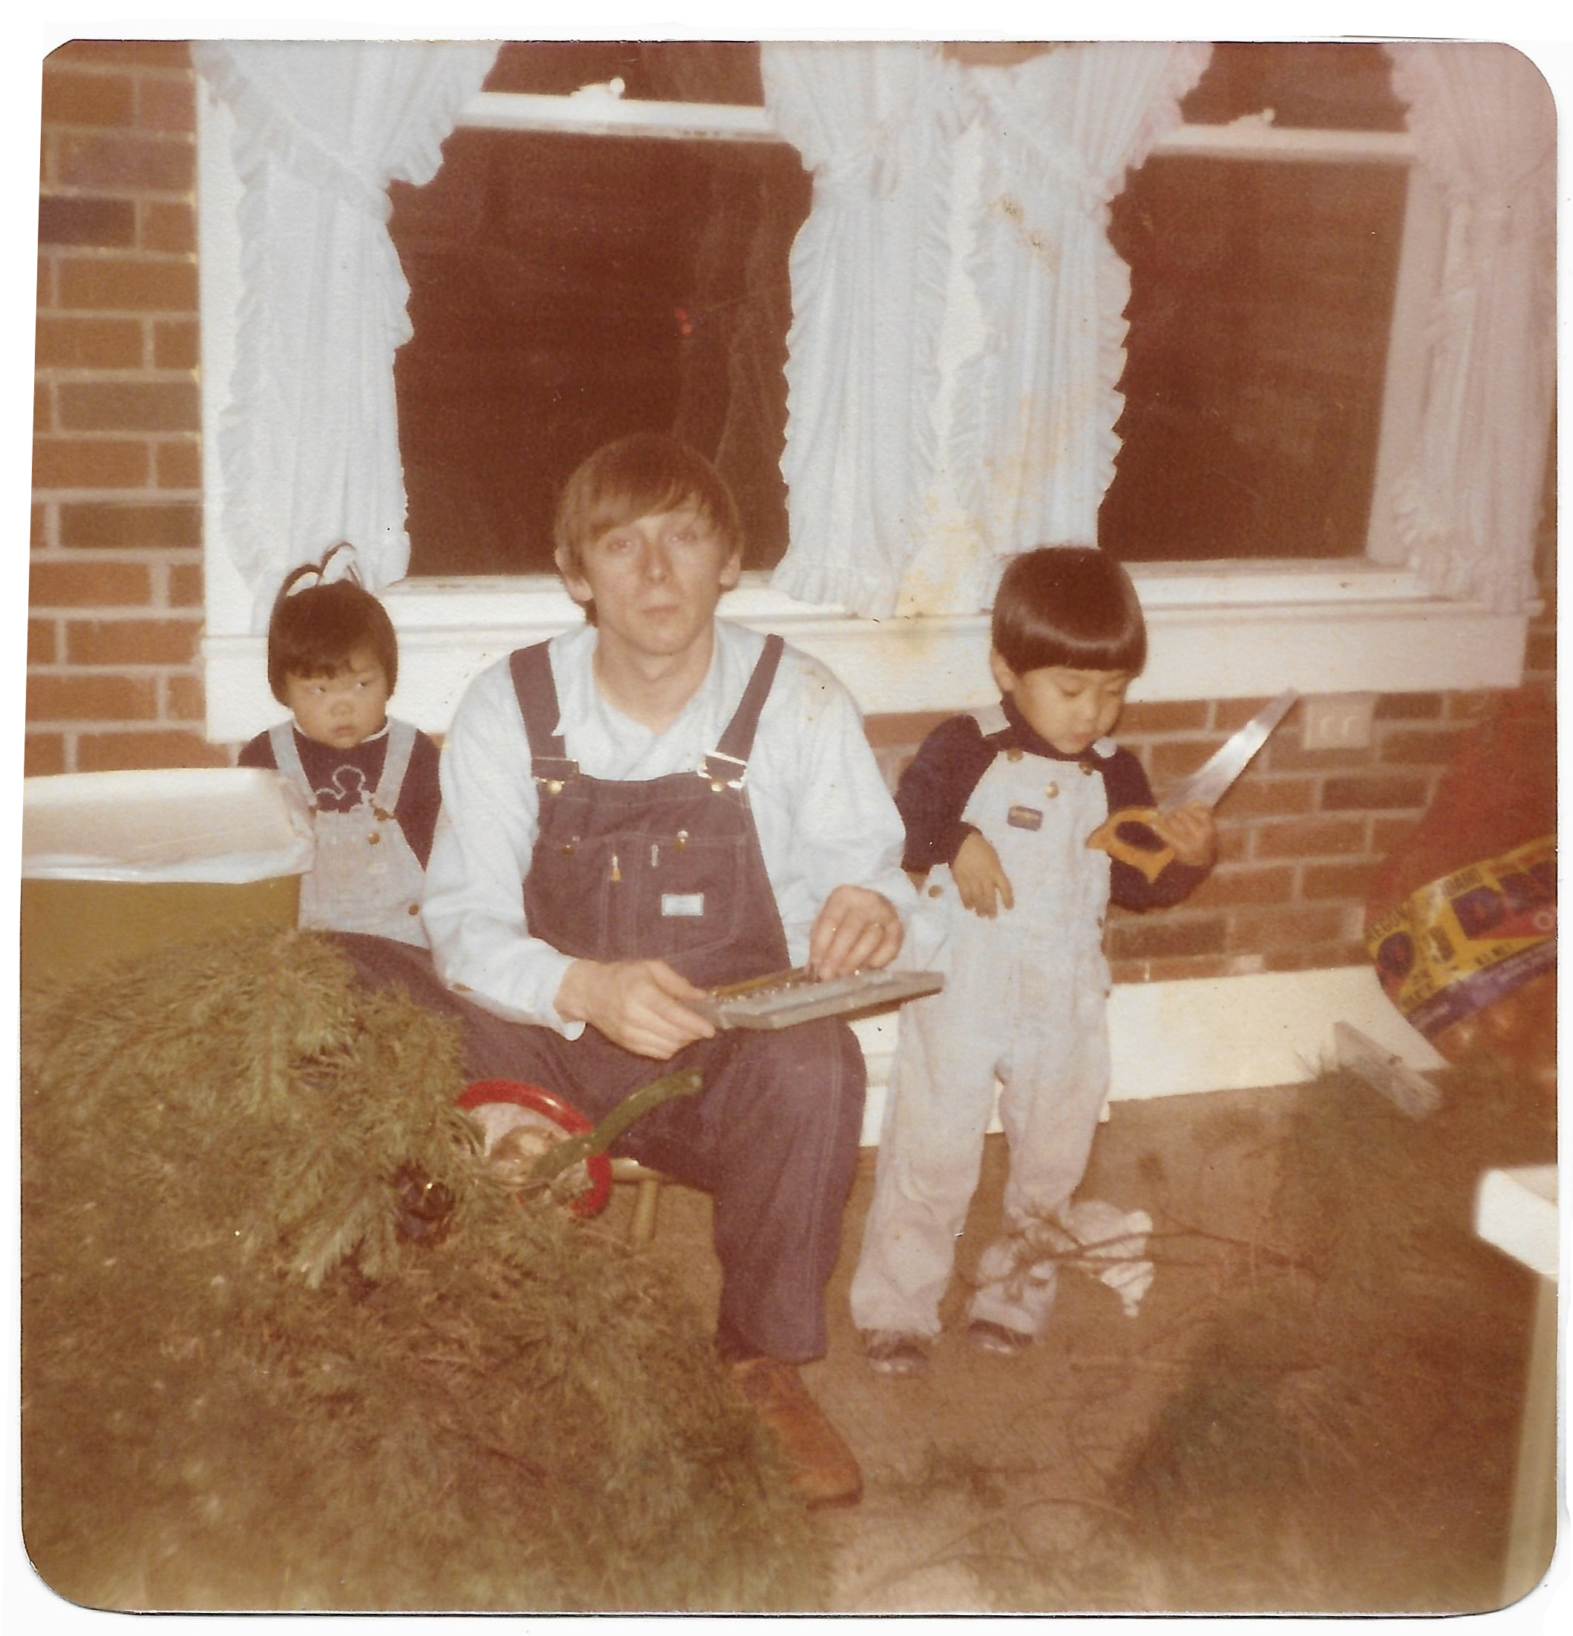
Many of Us Share Rural Roots

Slide 21
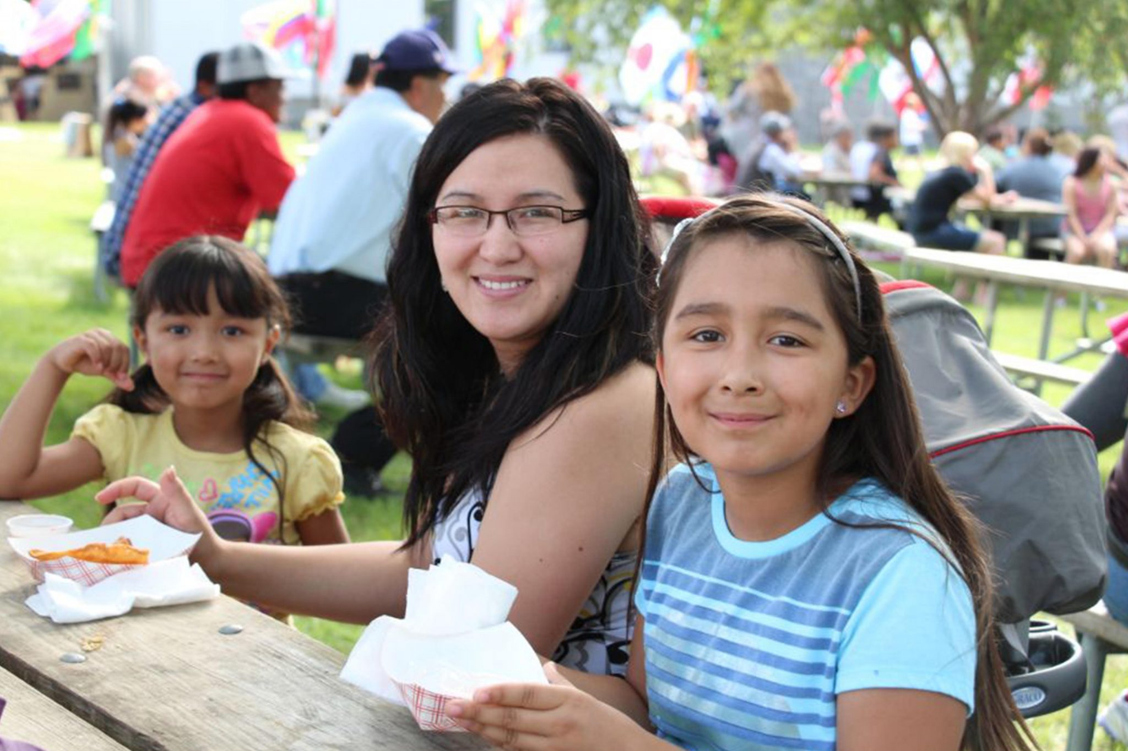
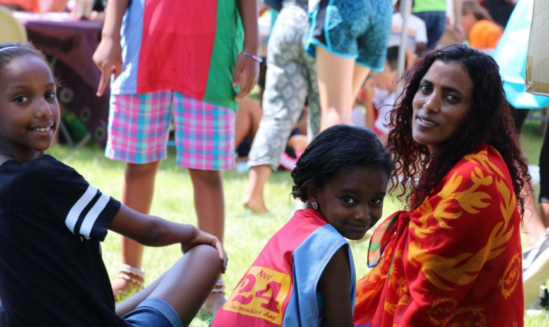
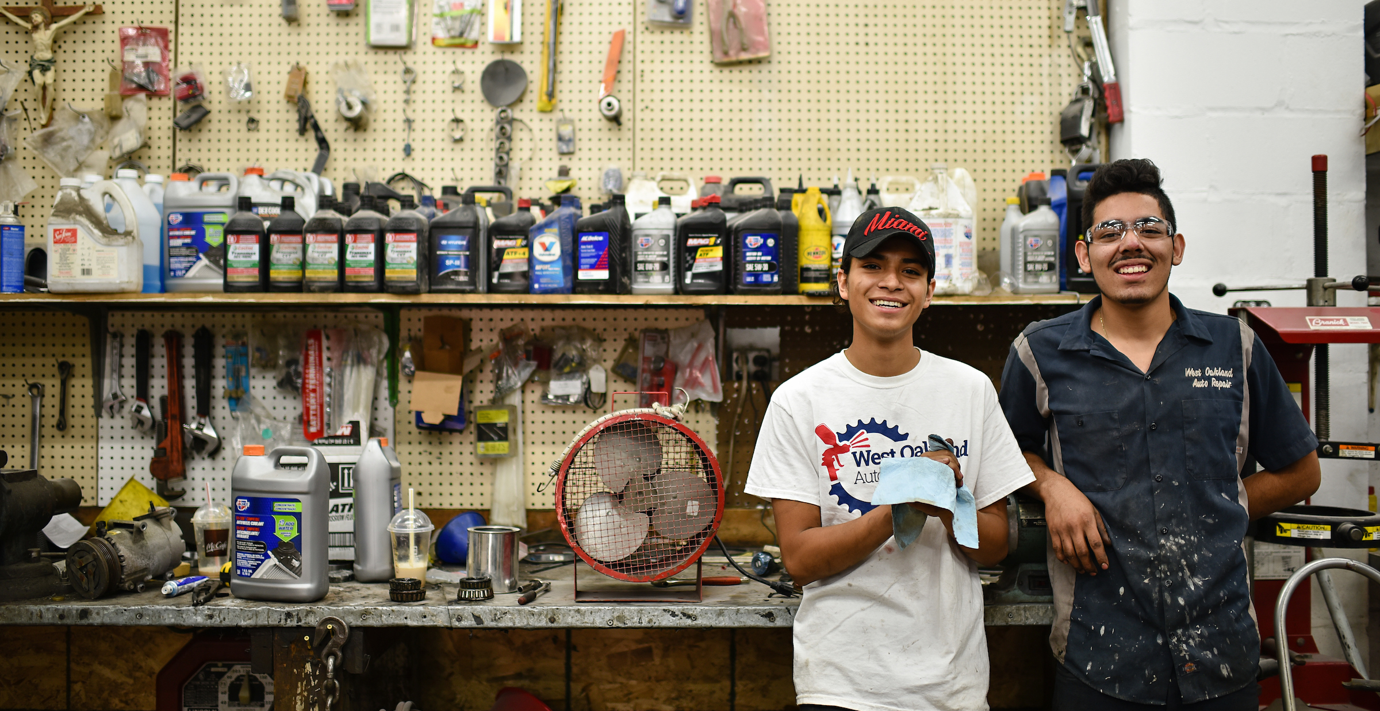
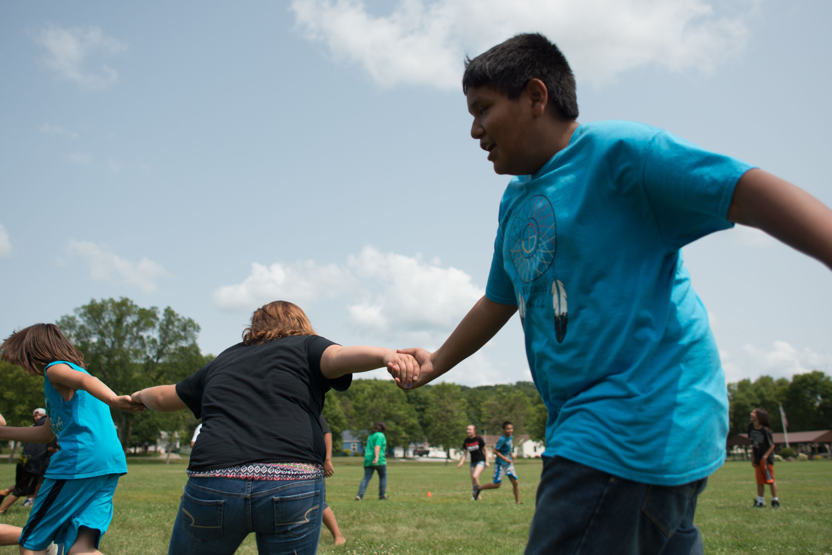
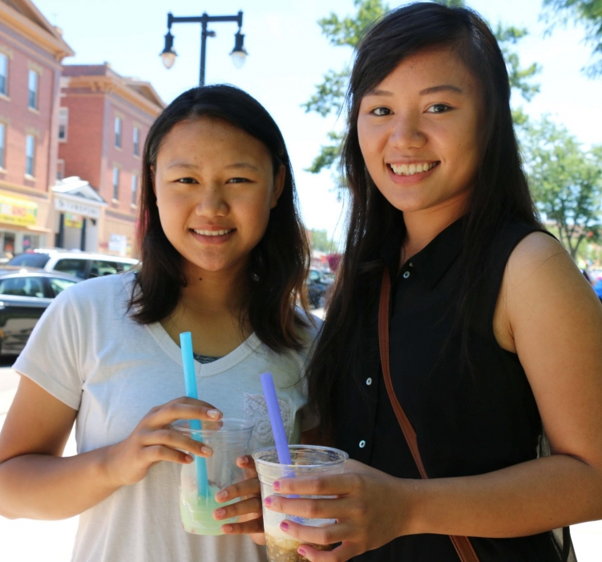

Slide 22
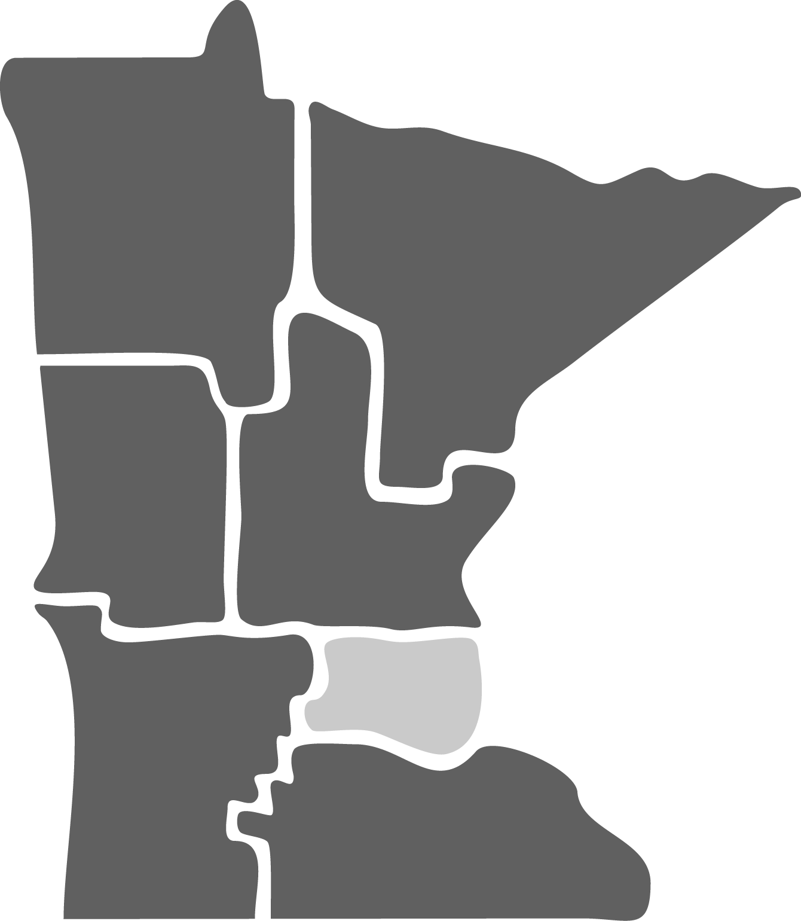
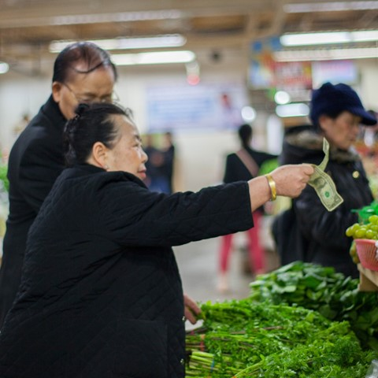
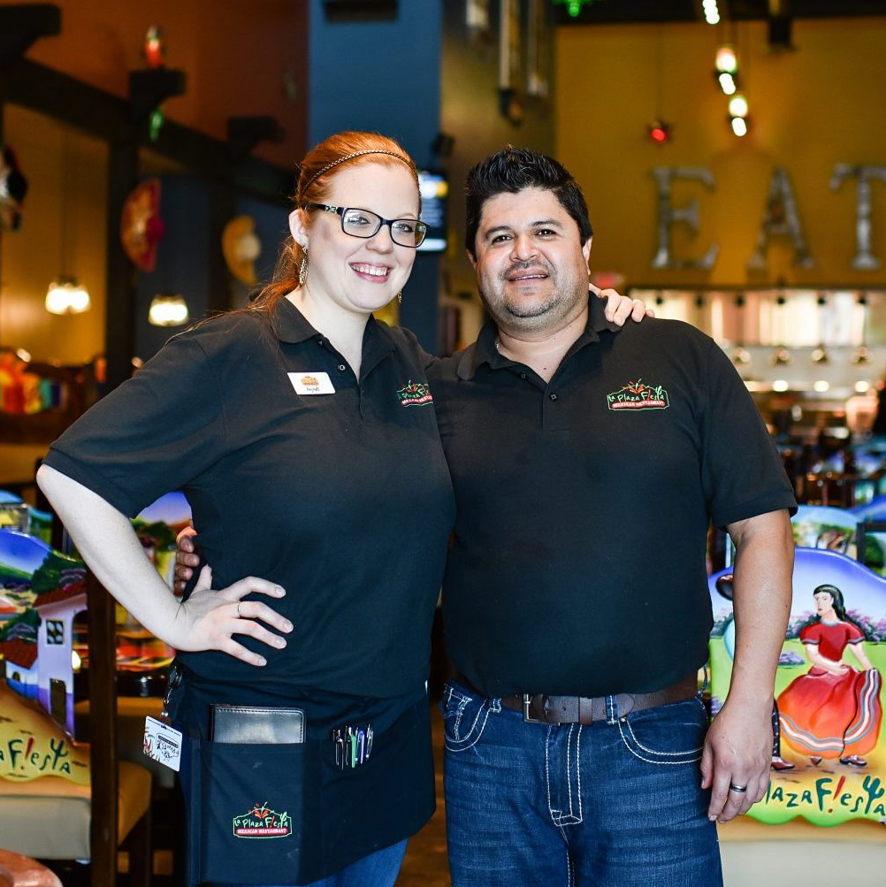
MIF Impact Since Inception
Total McKnight Contributions
$340M
Total Leveraged
$1.7B
Jobs Created or Retained 45,725

Slide 23
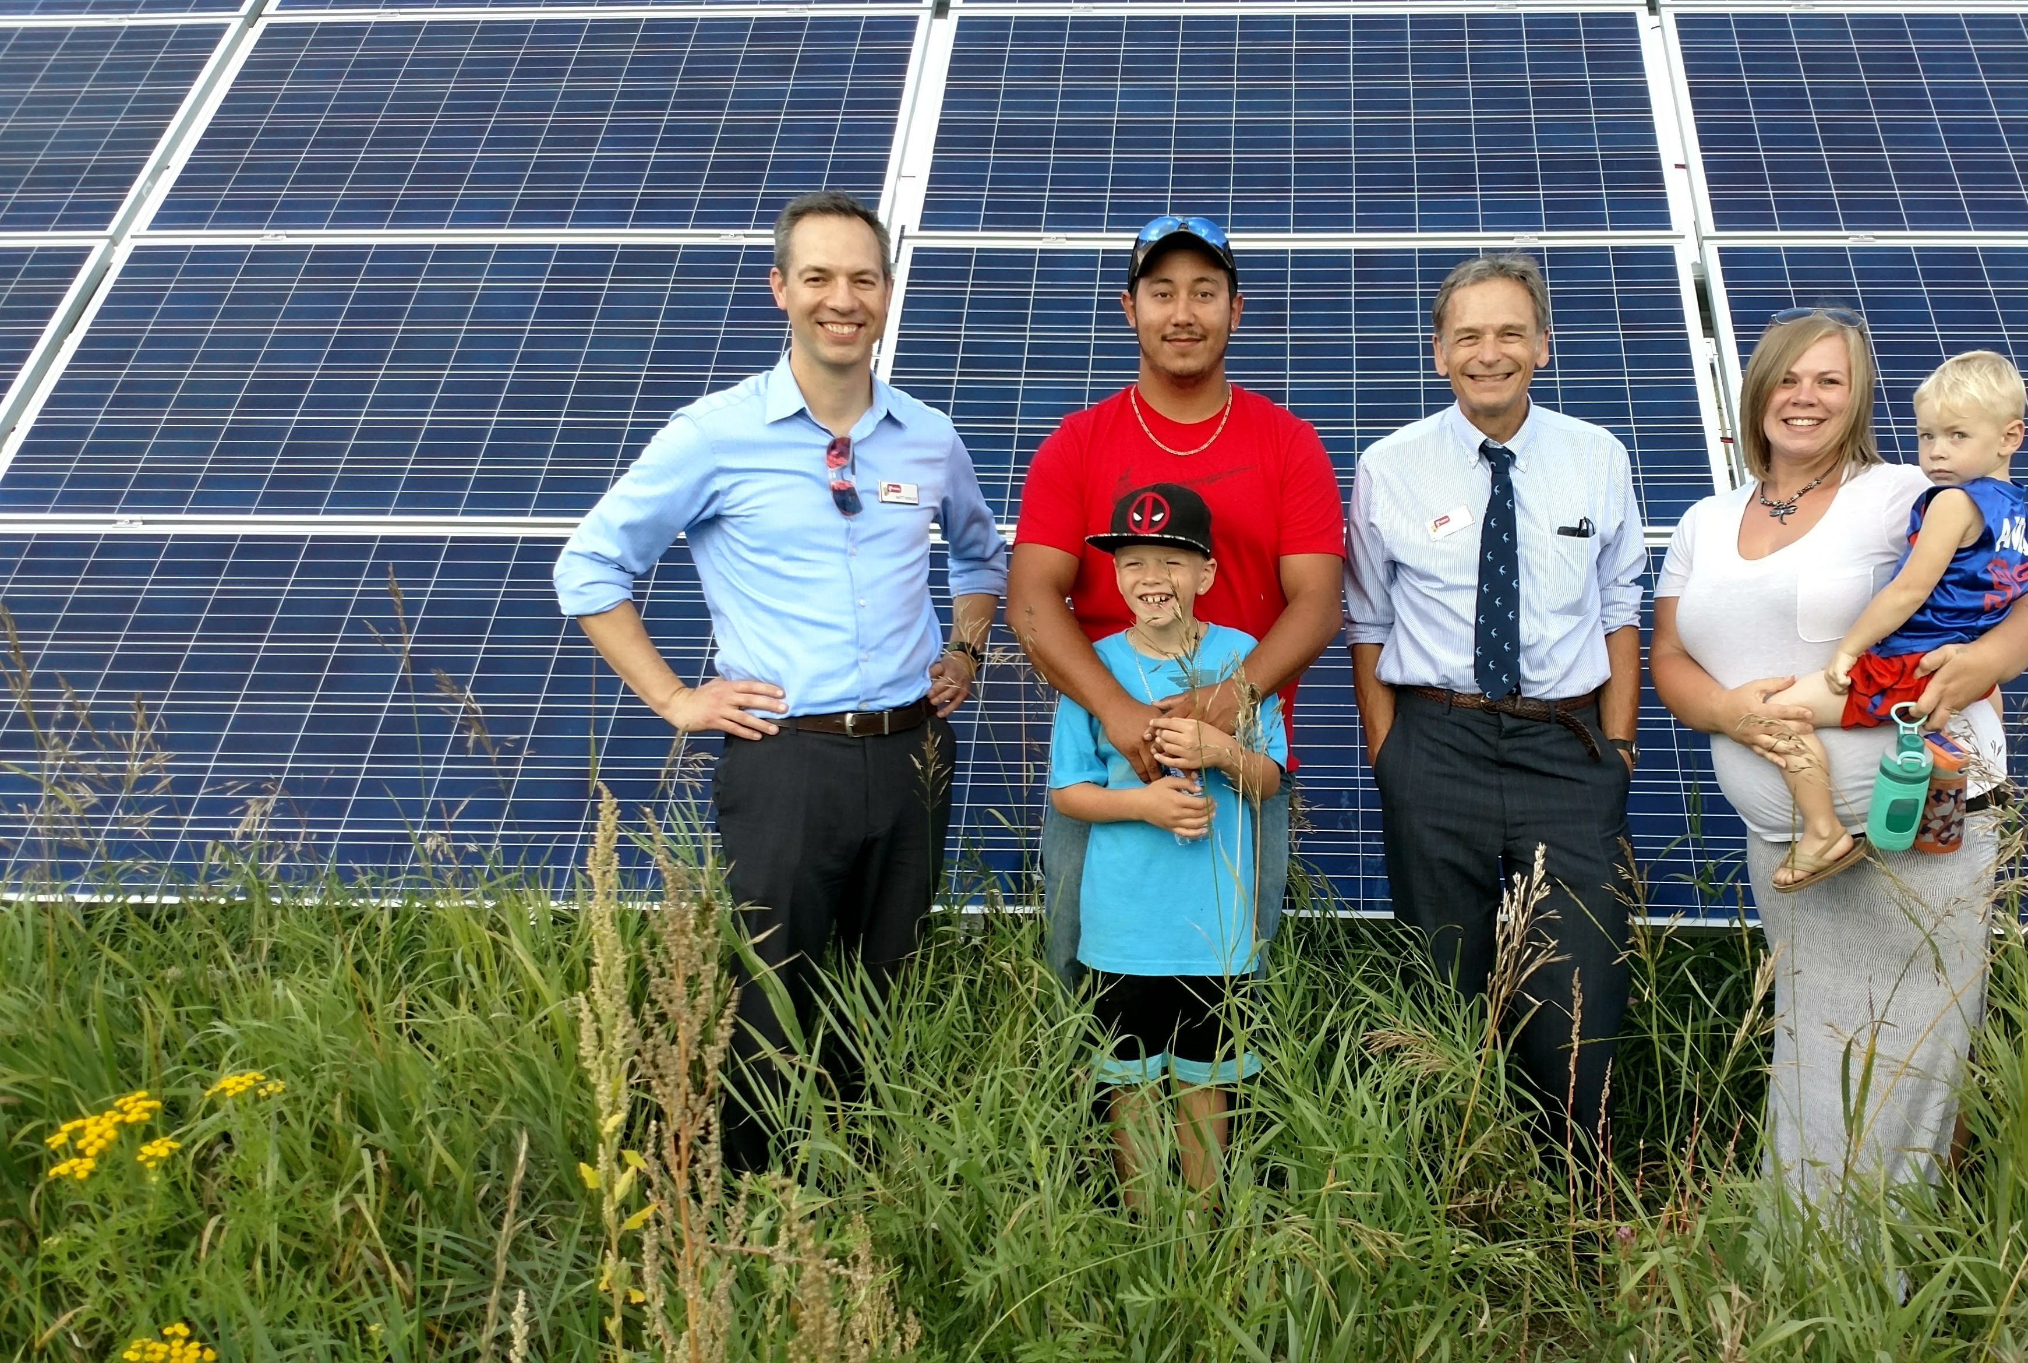
Notes:
In the photo: David Headbird (second from left) was one of three Leech Lake Tribal College students sponsored by an Initiative Foundation construction trades grant. Headbird, pictured with his family and Initiative Foundation staff members Matt Varilek (left) and Don Hickman (third from left), helped to install a 200-kilowatt community solar grid on Leech Lake land. IQ Magazine link: https://www.ifound.org/initiative-quarterly/workforce-wonders/sunny-future/

Slide 24
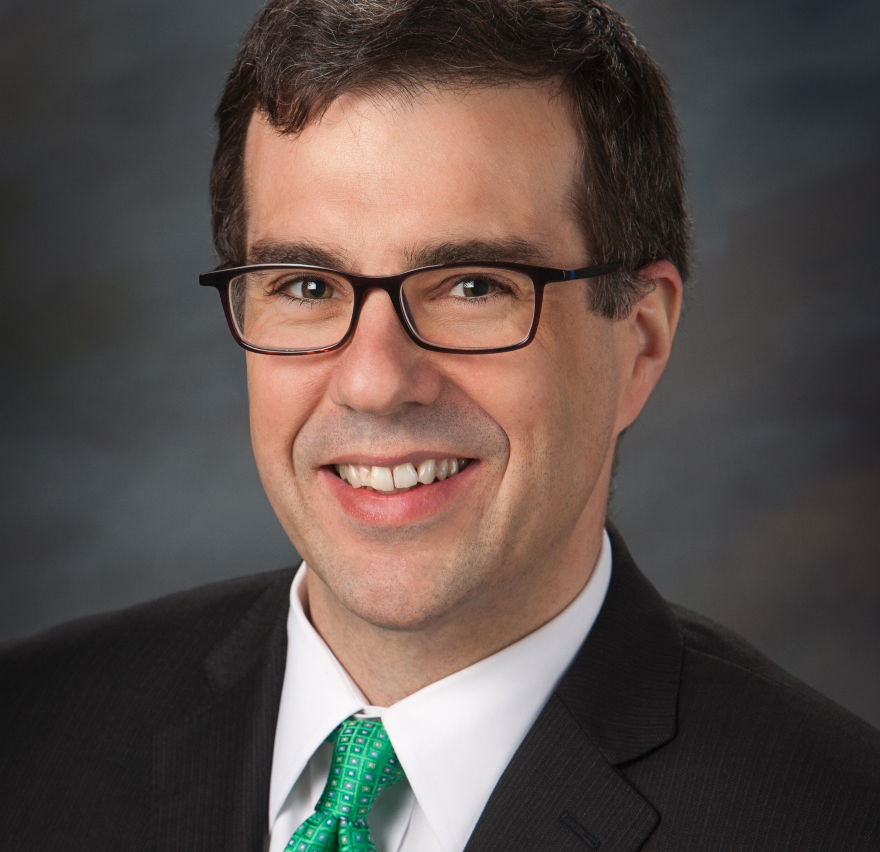
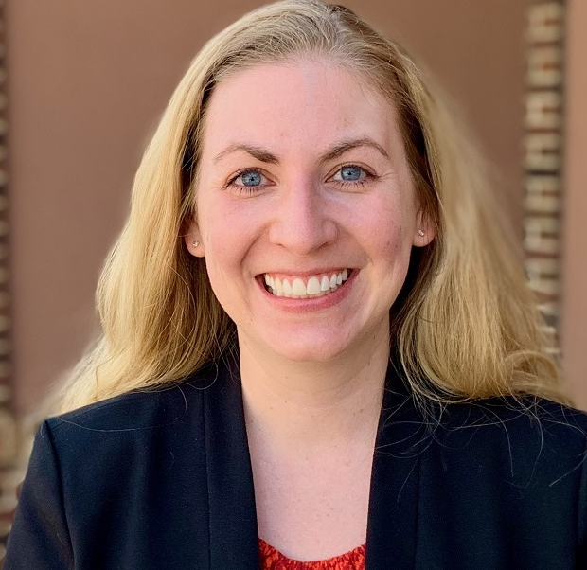
North to South: A Landscape of Opportunity
Erik Torch
Northland Foundation Director of Grantmaking, Duluth
Eunice Adjei
Jugaad Leadership Founder and Executive Director, St. Cloud
Erin Schutte Wadzinski
Kivu Immigration Law Founder/Owner, Worthington
Notes:
Eunice Adjei

Slide 25
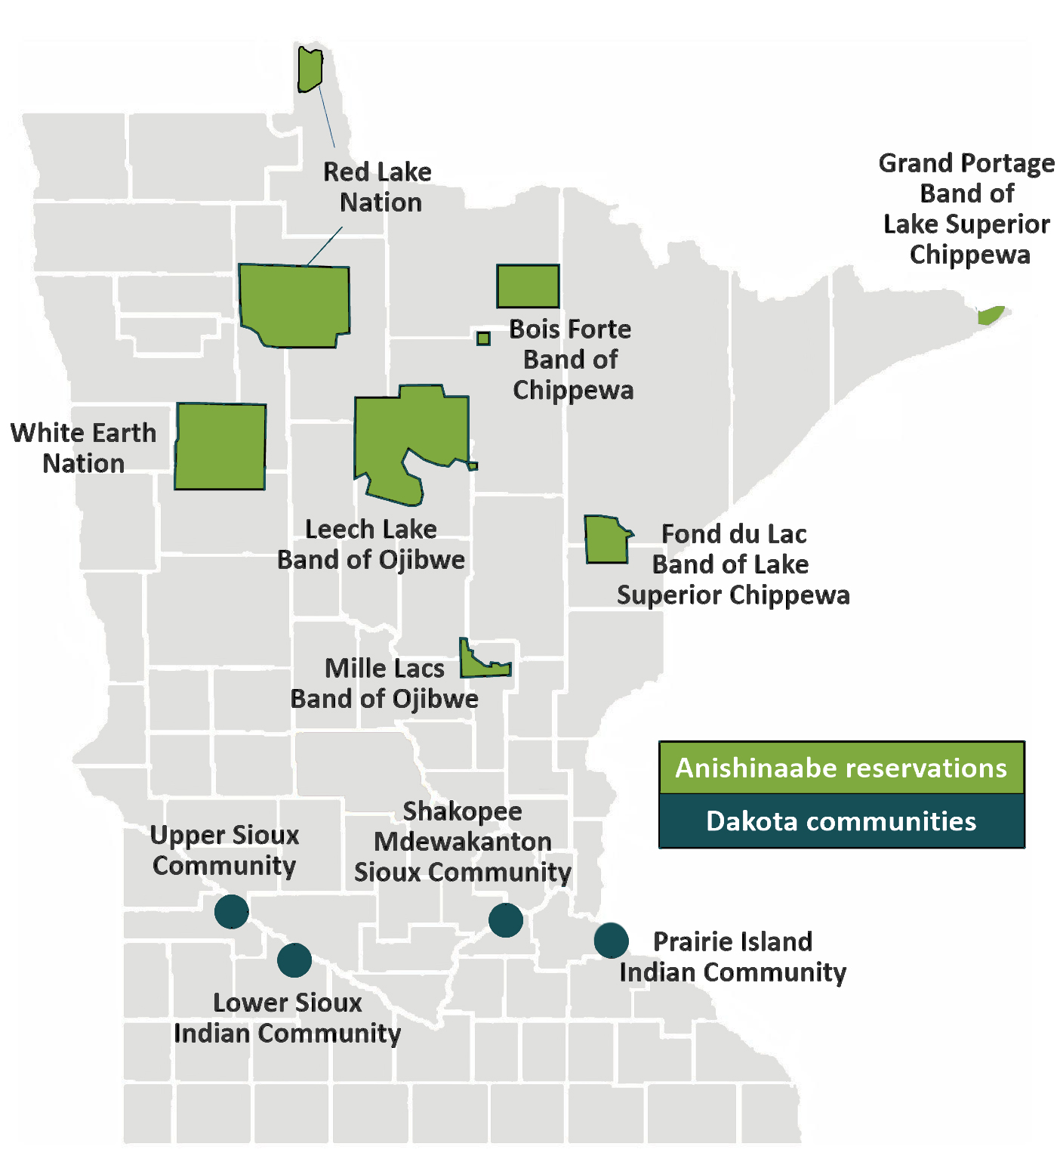
Tribal Nations

Slide 26
Notes:
Video link: https://www.youtube.com/watch?v=D4ZQM7kREHw

Slide 27
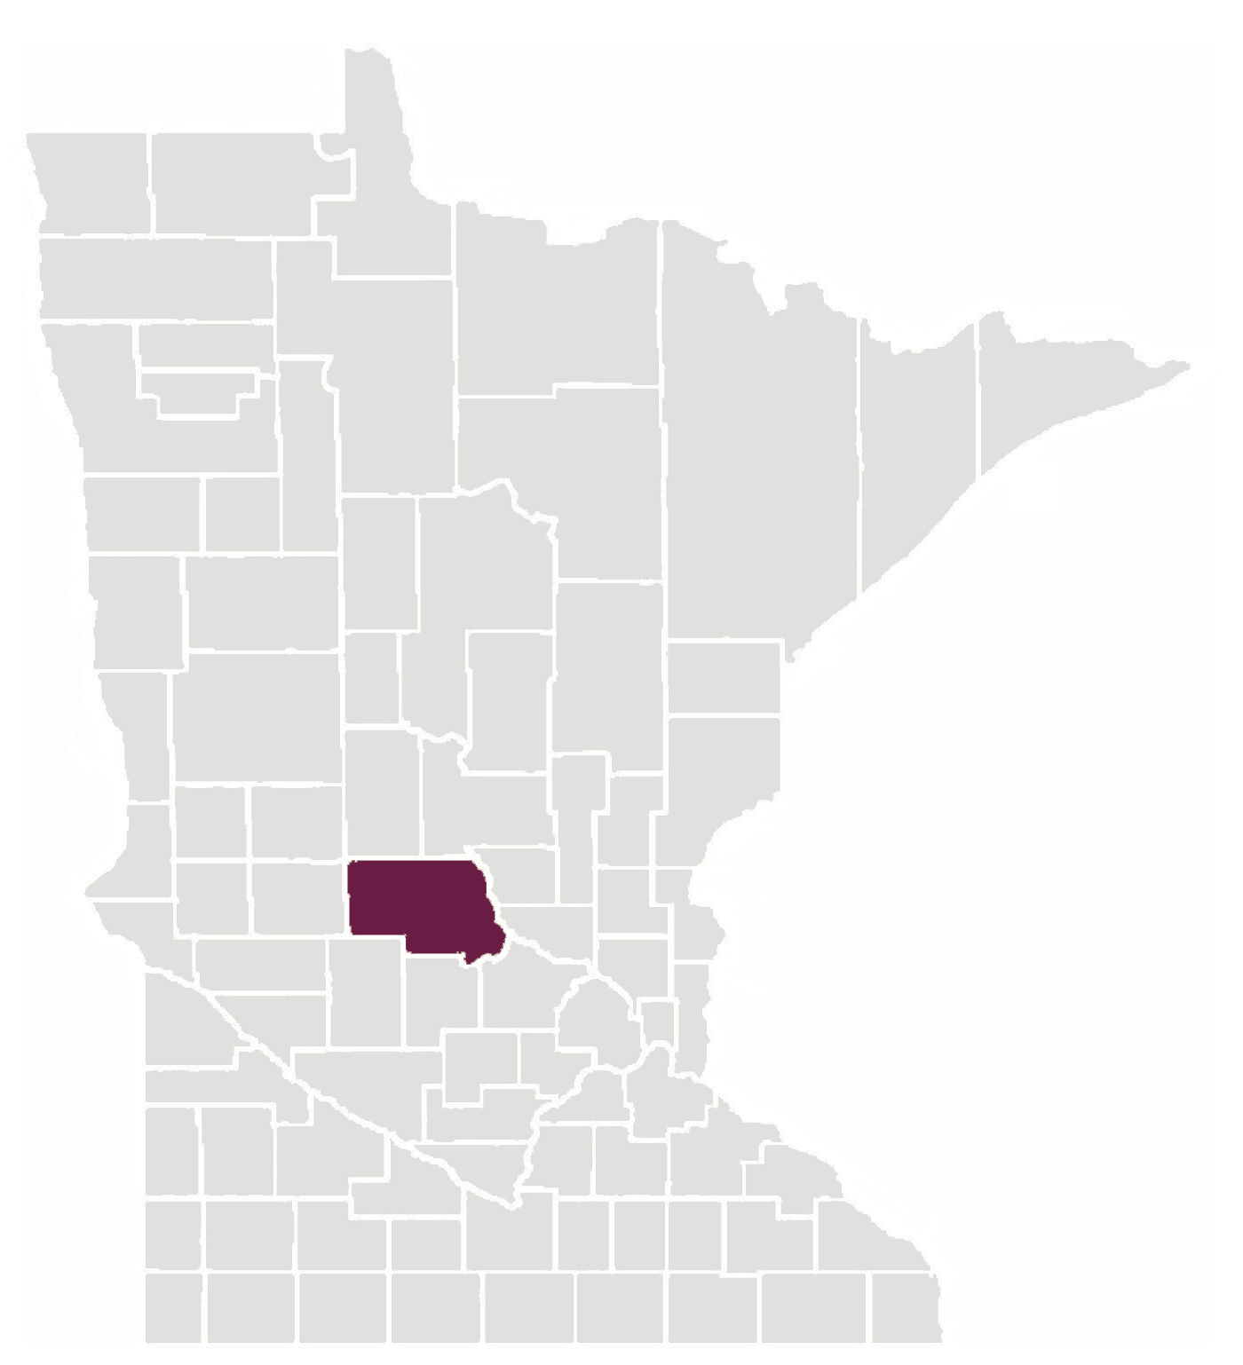
Saint Cloud

Slide 28
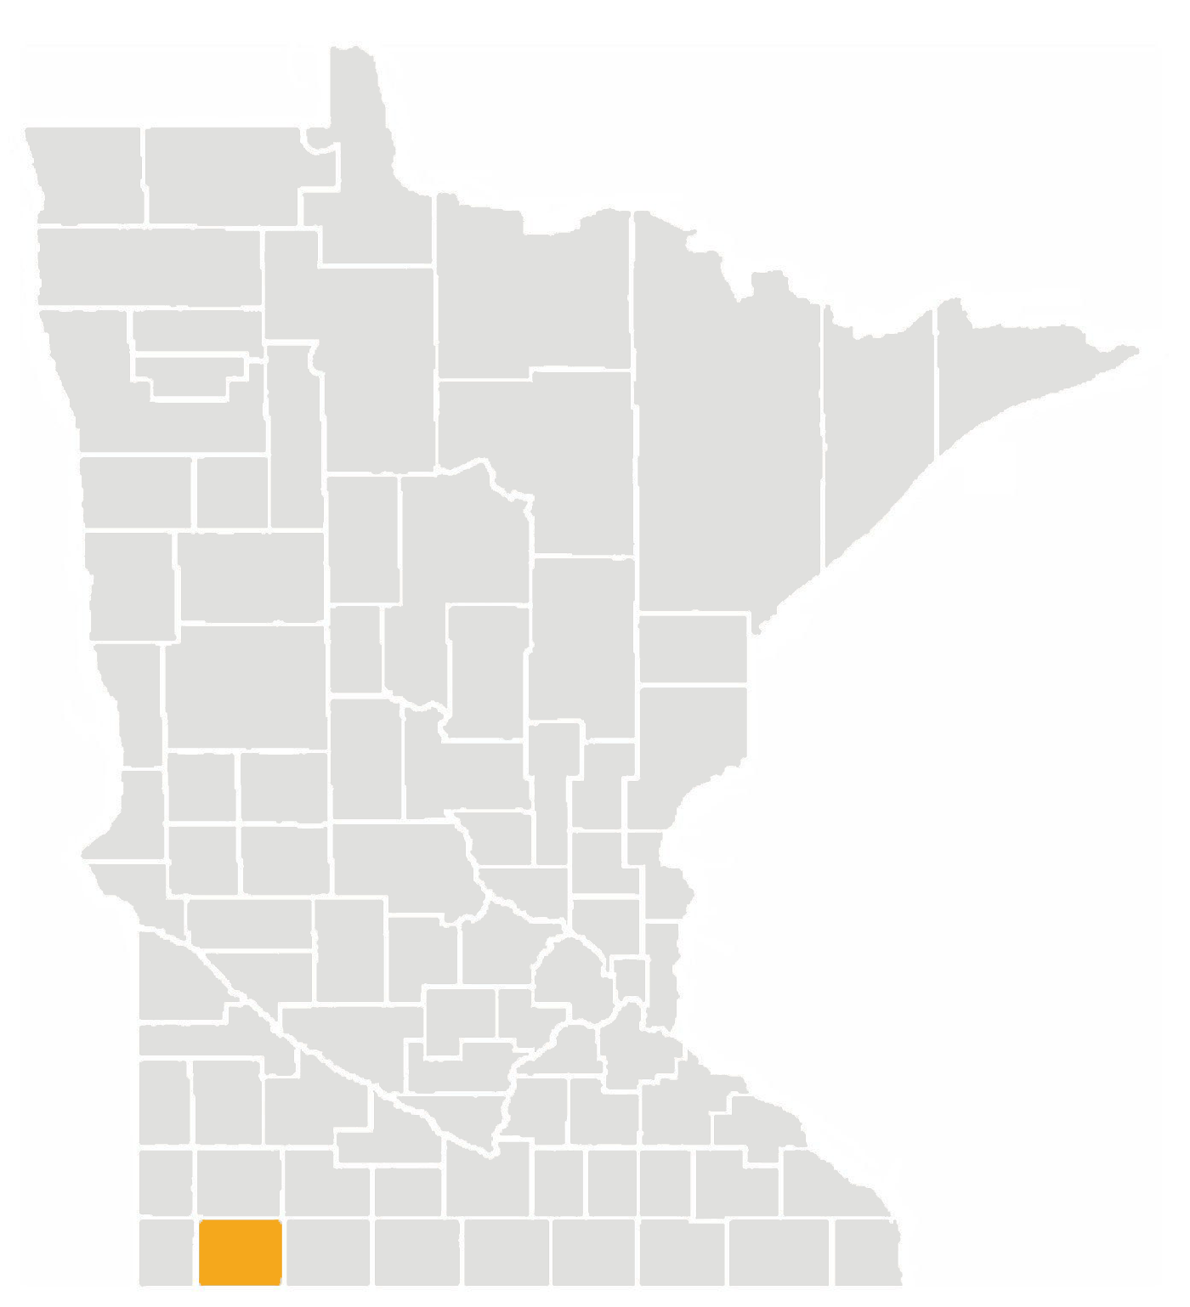
Worthington

Slide 29
Questions for Us?
(Up Next: We have some questions for you!)

Slide 30
Table Talk Time
Reflect & Connect: What are the barriers your organization faces and what opportunities do you see to grow your work in Greater Minnesota?

Slide 31
Table Talk Time
Actions & Tactics: What are some action steps you can take back to your organization today that will influence change tomorrow?

Slide 32
Opportunity Recap & Key Insights
In-state giving reflects a gap relative to population distribution, and this presents several opportunities – on any interest area, and especially political polarization and racial disparities.
Our sector is uniquely positioned to make change.
Lots of partners like those you've met today would love to help you explore actions steps.
MCF is taking a leadership role in response to high interest among members. Contact Susie or Paul.

Slide 33
Thank You!
Kara Inae Carlisle
kcarlisle@mcknight.org
Matt Varilek
mvarilek@ifound.org

