Slide 1
Principles for Philanthropy
We are better together.
Ideas for using this PowerPoint deck
Use the whole deck to introduce all of the principles at a staff or board meeting.
Focus on one slide – one of the 8 principles – for 15 minutes at the start of a meeting.
Use the questions at the end of the deck to engage your team in discussing one principle – or the entire set of principles:
What principles / concepts resonate most with your foundation?
What principles / concepts do you think will feel hardest, most complicated?
Where do you want to learn more?
Where is there agreement, something to build on?

Slide 2
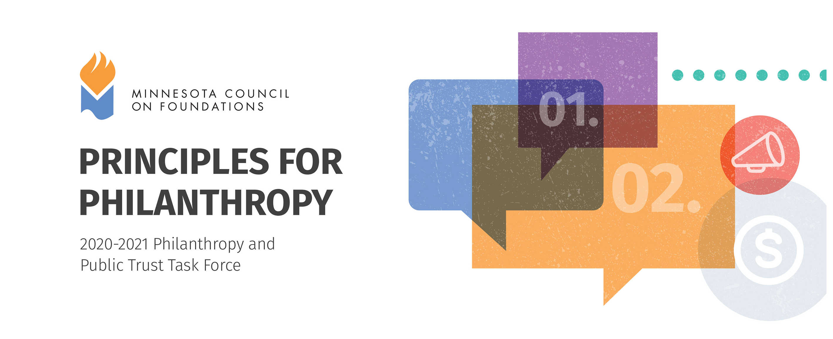
Principles for Philanthropy
Updated 2021
Notes:
Ideas for using this PowerPoint deck:
Use the whole deck to introduce all of the principles at a staff or board meeting.
Focus on one slide – one of the 8 principles – for 15 minutes at the start of a meeting.
Use the questions at the end of the deck to engage your team in discussing one principle – or the entire set of principles:
What principles / concepts resonate most with your foundation?
What principles / concepts do you think will feel hardest, most complicated?
Where do you want to learn more?
Where is there agreement, something to build on?

Slide 3
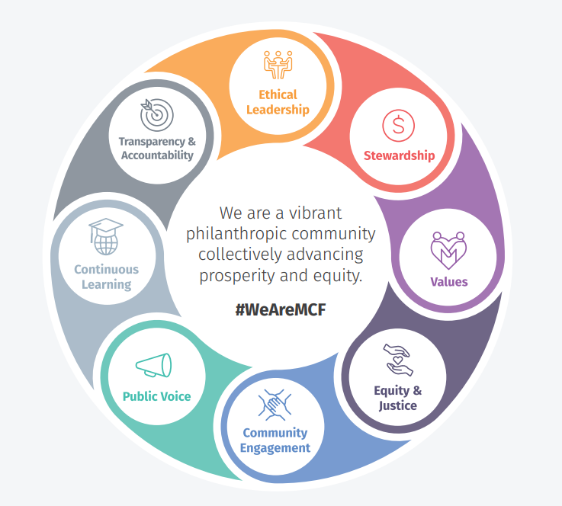
Principles for Philanthropy
Updated 2021

Slide 4
An Invitation from MCF Members
We are better together.
We hope you will join us, the members of the Minnesota Council on Foundations, in making these commitments – to ourselves, each other and to the community.
These Principles for Philanthropy were developed using a developmental framework, whereby each organization has its own starting point. Together MCF members commit to accepting these principles as a common baseline from which we will undertake individual, organizational and collective growth.
Wherever you see your institution on the spectrum of organizational development, the Principles for Philanthropy offer an opportunity for learning and improving. Through MCF, the philanthropic sector transforms our efforts to collectively advance prosperity and equity.

Slide 5
01. Ethical Leadership
Understand: We believe that ethical leadership is required to build and maintain community trust in philanthropy. This is achieved through adherence to laws, good governance and community-informed decision-making.
Begin: We serve our organizations and communities in a way that engenders trust. We adhere to all applicable laws and take seriously our fiduciary duties. In order to maintain trust, we seek to continuously improve our governance, decision-making processes and organizational culture.
Aspire: We actively engage the community in our governance and decision-making, balancing donor intent and community need. We strengthen community trust by including new and diverse voices on our governing bodies and decision-making teams.

Slide 6
02. Stewardship
Understand: Our organizations are established for charitable purposes and operate with a privileged tax status. We recognize that, in addition to money, foundation assets include investments, relationships, human resources, connections and networks, knowledge and expertise, and stature. Begin: We recognize our organizations’ roles as funders, employers, economic entities and community members. Through each of these roles, we use the wide range of assets held by philanthropy to create positive benefits and impact with our communities. Aspire: We use all of our assets to build equity and strengthen communities, as defined by the communities, themselves. We use all available tools such as values-based investing, impact investing and giving beyond minimum requirements, to generate community benefits.

Slide 7
03. Values
Understand: Having clear and transparent goals, missions and values allows us to be purposeful in philanthropy and facilitates accountability with communities and stakeholders. Begin: Our missions and goals are clearly stated and are transparent to the community. We hold ourselves accountable to them. We periodically examine our missions and goals for relevance, impact and alignment to our values. Aspire: We seek to understand and incorporate the values of our stakeholders and the communities we serve into our missions, values and goals. The community participates in examining our mission, values and goals for relevance, and holds us accountable to them.

Slide 8
04. Equity & Justice
Understand: We recognize two truths. Our organizations are created to promote the welfare of others. Our commitment to equity requires us to dismantle disparities in access to power, money and resources. At the same time, philanthropy is a system that is built on structural inequities and systemic racism. These inequities create a resource gap and power differential between philanthropy and the community. Begin: We are in a unique position to promote equity and justice. We seek to understand how intersectional inequities and racism manifest in our organizations and our communities. We work to become anti-racist individuals and organizations. In order to advance equity and justice, we listen to the community, honor their story and rely on their lived experience to inform our grantmaking. Aspire: We acknowledge our privilege in resources and resulting power. We commit to increase power sharing with our community, especially with communities that have been historically marginalized. We share power in decision-making, which increases community access to philanthropic resources. This increases equity and makes progress toward dismantling racism and eliminating systemic inequities.

Slide 9
05. Community Engagement
Understand: Philanthropy works best when it builds long-term community relationships rather than focusing on short-term transactions. Positive impacts increase when we hold mutually respectful, direct relationships with the community. As a result of community engagement, philanthropic organizations become more relevant and more accountable to our community. Begin: We listen to the desires of the community and we interact with the community in culturally appropriate, meaningful and respectful ways. We engage in continual and reciprocal listening and learning, cultural curiosity and humility. In our relationships, we respect the community’s time and resources and strive to give more than we receive. Aspire: We take time to understand our relationships with the community, align our aspirations and actions, and adjust our work, as needed. We solicit community critique and feedback. We strengthen our grantmaking through power sharing, joint decision-making and funding of solutions defined and led by the community.

Slide 10
06. Public Voice
Understand: Philanthropic organizations enjoy power and influence that we must use responsibly, both individually and collectively, for the greater good. Our public voice augments our grantmaking to demonstrate partnership in communities and to advance our goals. Begin: We form our public voice by listening humbly to those with lived experience on issues we seek to influence. We use our collective voice to share knowledge, educate ourselves and others, and impact change on issues that advance equity and strengthen our community. Aspire: We amplify the voice of communities that have been historically marginalized. We use our collective voice to impact change in public policy and public opinion on issues important to our communities. We use our resources to amplify community voices and support grassroots organizing and advocacy.

Slide 11
07. Continuous Learning
Understand: We have unprecedented access to information from local and global sources including science, research and community networks. Our communities offer rich information about the human impact of policies and resource distribution. We are obligated to use various information sources to actively learn and strengthen our practice. Begin: We are curious about our work and engage in activities that help us to consider new viewpoints and address individual biases. Through a range of learning activities including research, self-assessment, evaluation, professional development and community engagement processes we seek and use information that improves our grantmaking and expands our understanding of the community. Aspire: With the community, we engage in ongoing learning and jointly define funding priorities. We respect many cultural ways of learning and knowing and work to achieve individual and organizational cultural competency. We promote continuous learning with our teams and our grantee partners. We improve our work by offering and using peer feedback.

Slide 12
08. Transparency & Accountability
Understand: Transparency builds trust and strengthens our accountability to the community. By being transparent, we are accountable to our mission, values and goals. Begin: We exhibit transparency by being clear, consistent and timely in our communications, decisions and commitments. We share information publicly in order to meet regulatory requirements and uphold community expectations, in the context of our missions. We demonstrate accountability by learning from community feedback and critique. Aspire: We consider state and federal regulatory requirements to be the minimum standard of transparency. We excel at transparency and accountability by engaging the community in decision-making and external evaluation of our work.

Slide 13
A Path of Learning
Applying High Standards
As a member of MCF, you signal that you accept the spirit of the Principles for Philanthropy and you are on a path of learning and organizational growth, appropriate to your community context.
Private foundations, public charities, family foundations, corporate giving programs and other organizations make up MCF’s membership. Each type of organization will interact with these principles in unique ways. Additionally, staff, board, volunteers and donors will arrive at different developmental levels.
Though the work varies by organization—we invite you to join us on a path toward a universal goal: build public trust while collectively advancing prosperity and equity.
mcf.org/principles-practices

Slide 14
Conversation Starters
Applying High Standards
MCF offers various avenues for continuous learning and engagement with the Principles for Philanthropy. Join MCF at educational workshops, briefings or conference sessions. Additional tips and strategies will be posted online at mcf.org/principles-practices in early 2022.
What principles or ideas resonate most with your foundation?
What principles or ideas do you think will feel hardest, most complicated?
Where do you want to learn more?
Where is there agreement, something to build on?

Slide 15
