Slide 1
We’re All Disaster Funders Now
Photo from Catholic Charities of Northern and Central Missouri

Slide 2
We’re All Disaster Funders Now
February 8, 2023
Minnesota Council on Foundations Annual Conference
Cari Cullen
Don Hickman
Sarah Carlson
Nancy Fasching
Director, Midwest Early Recovery Fund Center for Disaster Philanthropy
Vice President for Community and Workforce Development Initiative Foundation
Executive Director Willmar Area Community Foundation
Vice President of Community Impact
Southwest Initiative Foundation

Slide 3
Who else is in the room?

Slide 4
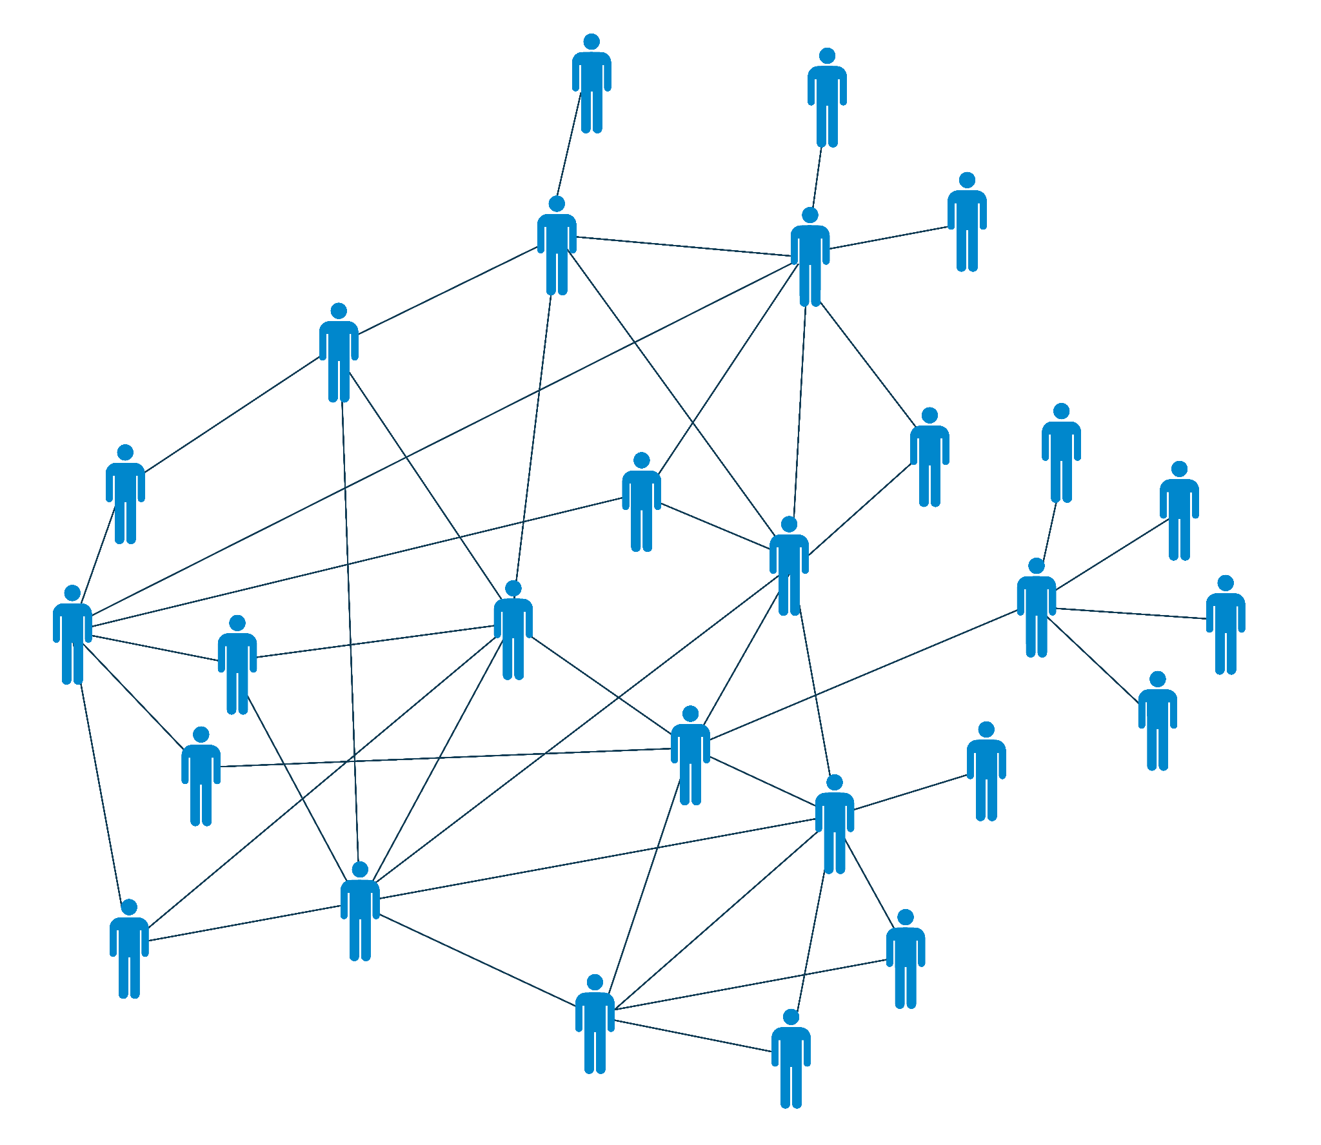
Network of Networks
The Funders Network
PPREP (Philanthropic Preparedness, Resiliency and Emergency Partnership)
Center for Disaster Philanthropy
Midwest Early Recovery Fund
Minnesota Council on Foundations
Minnesota Disaster Philanthropy Working Group
Margaret A. Cargill Philanthropies
Community Foundations

Slide 5
What is a disaster?
Vulnerability
Hazard
Diseases and epidemics
Drought
Earthquake
Flooding
High winds (cyclone, hurricane, typhoon)
Landslide
Volcanic Eruption
War/conflict
Root Causes
Dynamic Pressure
Unsafe Conditions
Limited Access to:
Power
Structures
Resources
Lack of:
Local institutions
Training
Appropriate skills
Local investment
Local markets
Press freedom
Ethical standards in public life
Macro-forces
Rapid population growth
Rapid urbanization
Arms expenditure
Debt repayment schedules
Deforestation
Decline in soil productivity
Fragile Physical
Environment
Dangerous locations
Unprotected buildings and infrastructure
Fragile Local Economy
Livelihoods at risk
Low-income levels
Vulnerable Security
Special groups at risk
Lack of local institutions
Public Actions
Lack of disaster preparedness
Prevalence of endemic disease
Disaster
Vulnerability + Hazard
Notes:
Evergreen slide

Slide 6
Are disasters NATURAL?
Disasters are often depicted as great levelers, victimizing rich and poor alike. The effects of disasters on populations are anything but random... The disaster vulnerability of individuals and groups is associated with a number of socioeconomic factors that include income, poverty, and social class; race, ethnicity, and culture; physical ability and disability; language competency; social networks and social capital; gender; household composition; homeownership; and age... The same factors that disadvantage members of society on a daily basis also play out during disasters.
~ Dr. Kathleen Tierney, The Social Roots of Risk: Producing Disasters, Promoting Resilience
Notes:
Evergreen slide

Slide 7
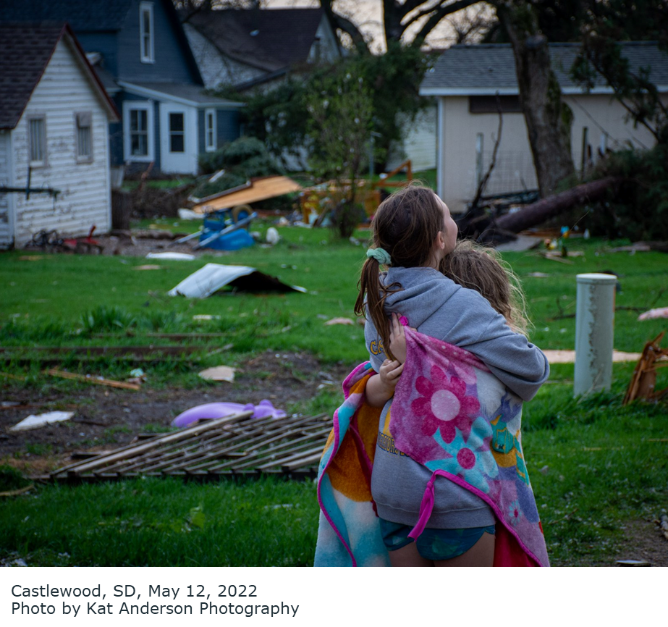
WHAT IS “DISASTER
RECOVERY”?
Disaster recovery is the process of improving individual, family and community resiliency after the occurrence of a disaster. Recovery is not only about the restoration of structures, systems and services – although they are critical. A successful recovery is also about addressing sources of inequitable and unjust outcomes, and individuals and families being able to rebound from their losses and sustain their physical, social, economic, mental, emotional and spiritual well-being.
Castlewood, SD, May 12, 2022 Photo by Kat Anderson Photography
Notes:
Evergreen slide

Slide 8
All funders are disaster funders
Housing
Children / Education
Food Security
The devastating impact of disasters is often multi-dimensional, entailing a holistic approach to equitable recovery.
Mental Health
EXAMPLES OF A HOLISTIC RECOVERY

Slide 10
Expert Resources
Special Reports
Measuring the State of Disaster Philanthropy
Covid-19 and Philanthropy
U.S. Household Disaster Giving Report
Disaster Philanthropy Playbook
Website
Blogs, Issue Insights, Disaster Profiles, Weekly Disaster Updates
CDP Staff
Speaking engagements, Analyses, Opinion Pieces, Consulting Services
Webinars
disasterphilanthropy.org
Notes:
Evergreen slide

Slide 11
Thank You
Cari.Cullen@disasterphilanthropy.org
CONNECT WITH US
DISASTERPHILANTHROPY.ORG
@FUNDS4DISASTER
Notes:
Evergreen slide

